Slide 1
An Expense and Income Tracking Mobile App with OCR to Import Receipts Intelligently
By: Jiao Shaobo
May 8, 2023

Slide 2
Agenda
01. Introduction
02. Literature Review
Motivation and Objectives
Review on existing apps.
Development Tools Selection
03. Design
04. Outcomes
05. Closing
Modules designed for the mobile app
Elaboration on developed modules
Conclusion and Future Work

Slide 3

Introduction
This Final Year Project recognized drawbacks of existing money tracking apps in the market and made improvements by developing a smart money tracking app deployed with OCR technology to import receipts intelligently.
During the app development, basic and advanced skills were utilized to achieve necessary functions including money management, receipt management, statistical report generation and records import and exporting.

Slide 4
Review on Existing Apps
Money Manger: Budget Planner
Spending Tracker
Money Manager Expense & Budget
Intuitive and easy to use UI
Statistical Reports with charts
No advertising, no feature restriction
No support of importing records from external files
Lack of details for special records, no receipt storing
Intuitive and easy to use UI
Comprehensive functions and settings
Lack of statistical reports and charts
Redundant steps for one operation
Lack of details for special records, no receipt storing
Ads and Limited features
Intuitive and easy to use UI
Comprehensive functions and settings
No support of importing records from external files
Lack of details for special records, no receipt storing
Ads and Limited features

Slide 5
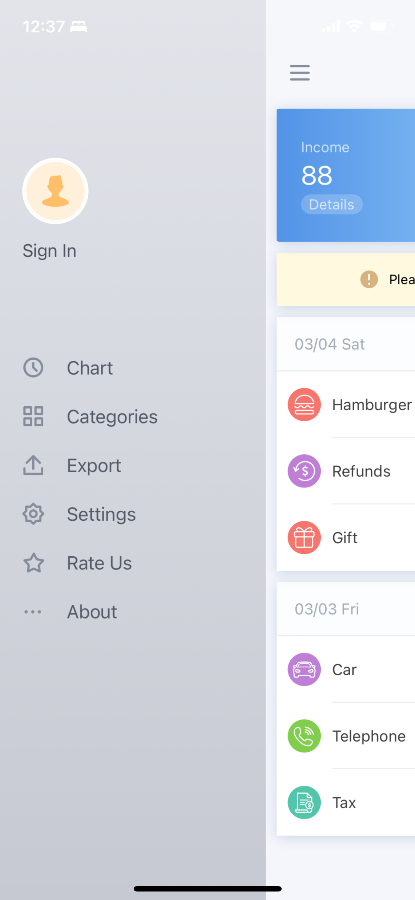
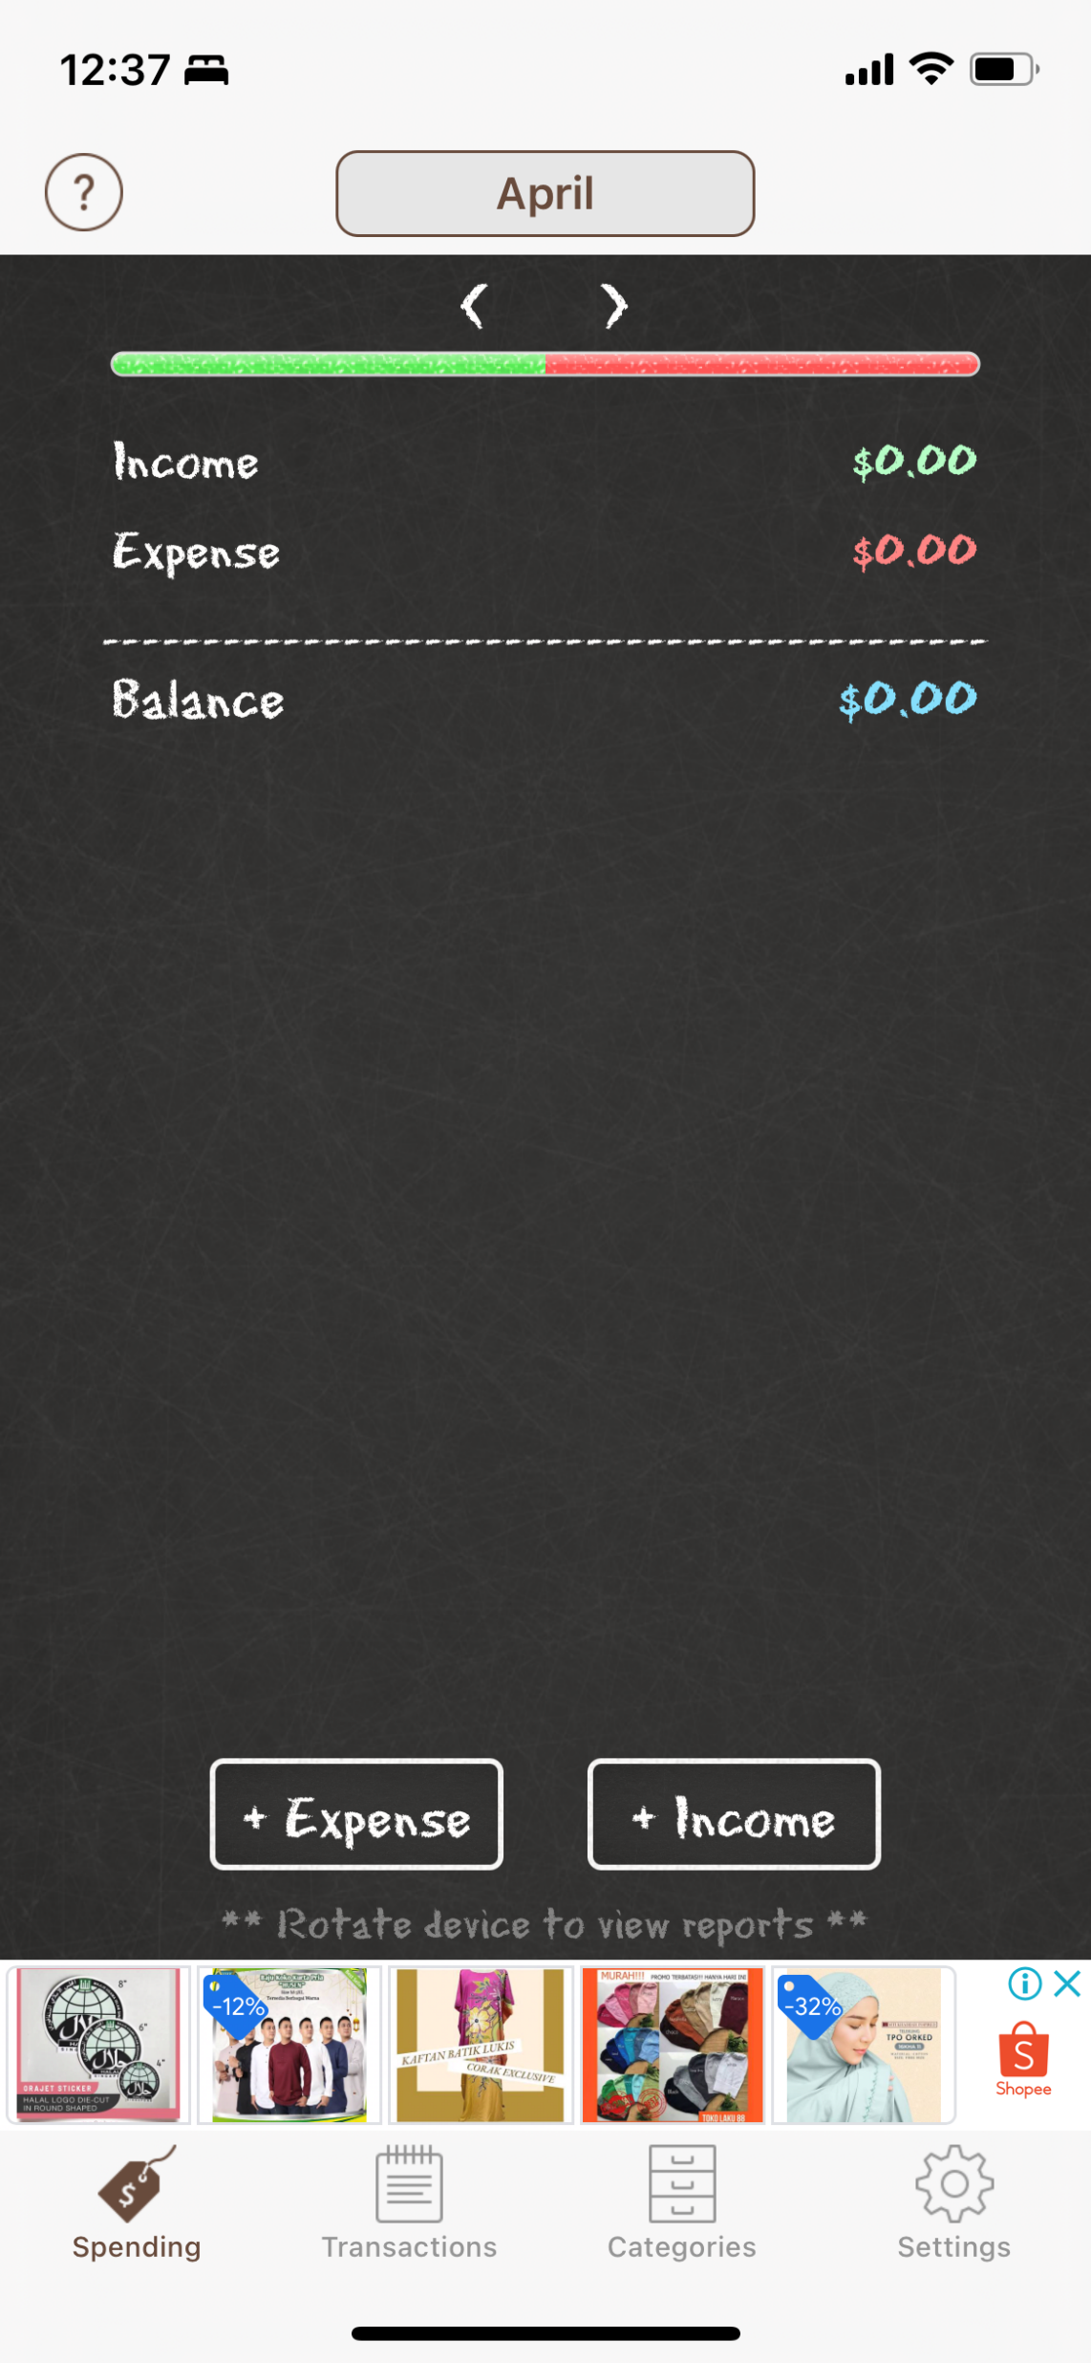
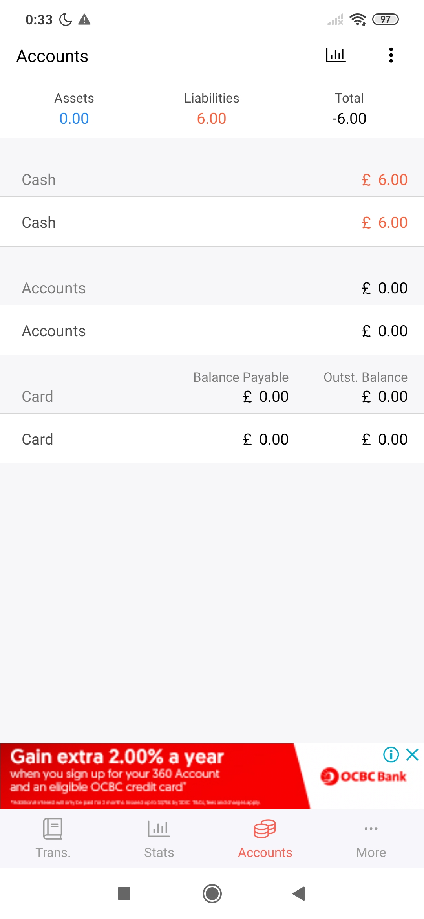

Slide 6
Development Tools
Android Platform and Java Programming
Google’s ML Kit
Native vs Cross-platform
Java vs Kotlin
Machine Learning APIs for mobile app development
Android Studio
Other Open-source Libraries
Official IDE for Android app development
Managing codes and resources; debugging; emulators
MPAndroidChart, Apache POI
SQLite Database and Room
Native support on Android
Room simplifies database operation

Slide 7
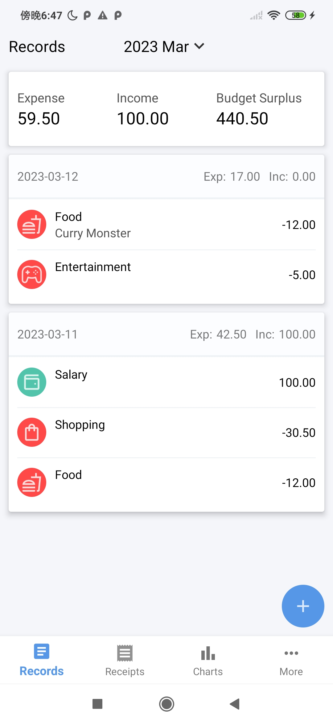
Design
Navigation
Records Management
Receipts Management
Statistical Reports and Charts
Import and Export Records

Slide 8
Outcomes

Slide 9
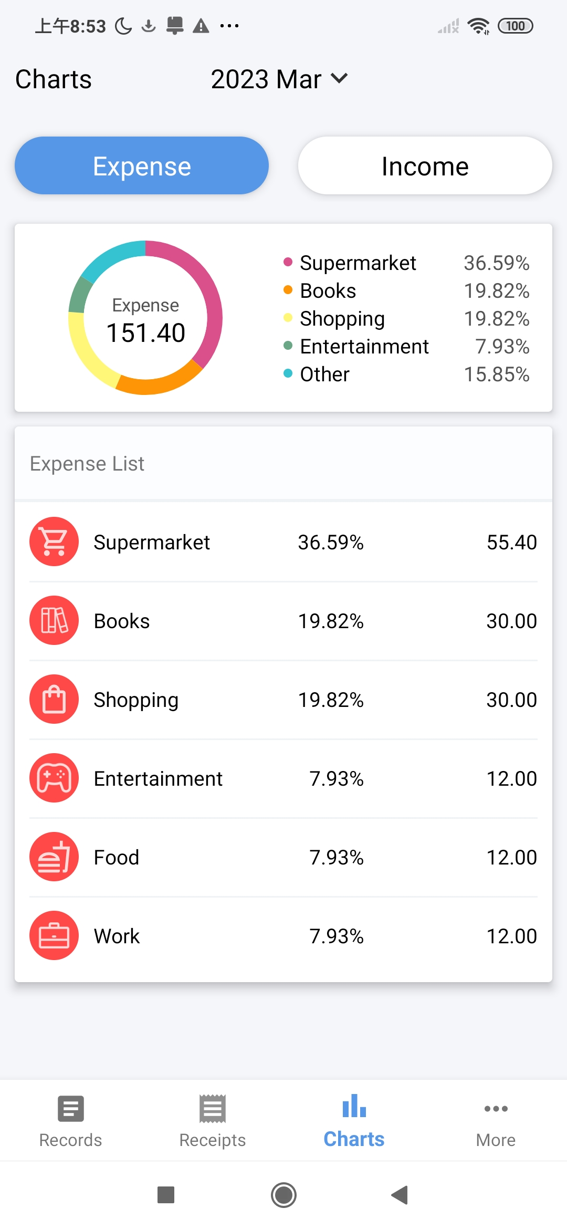
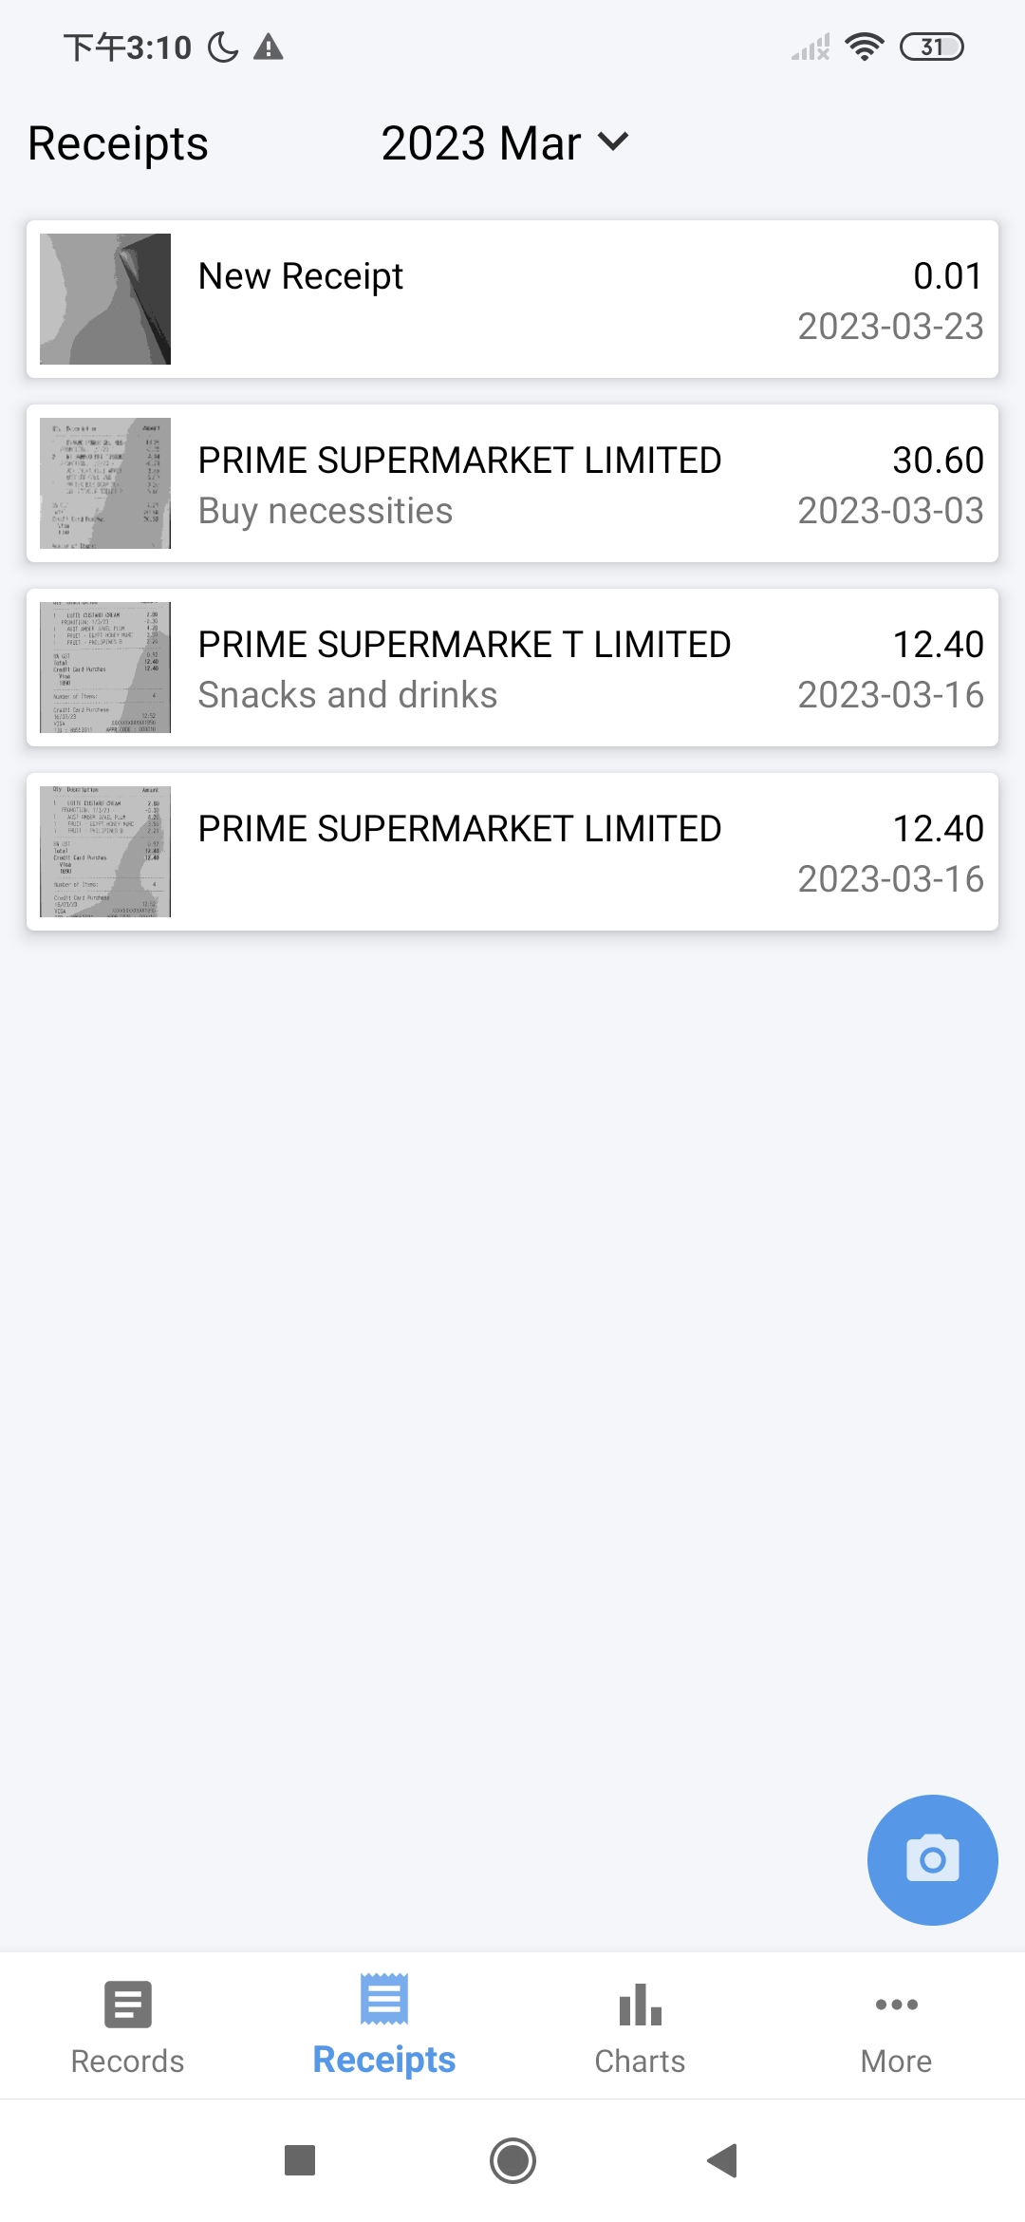
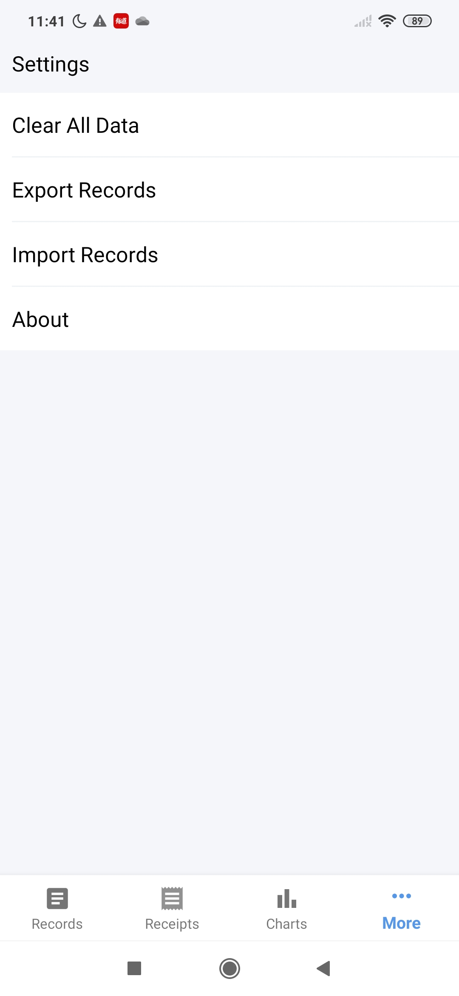
Navigation
Navigation between different modules using
Bottom Navigation Bar and Fragments

Slide 10
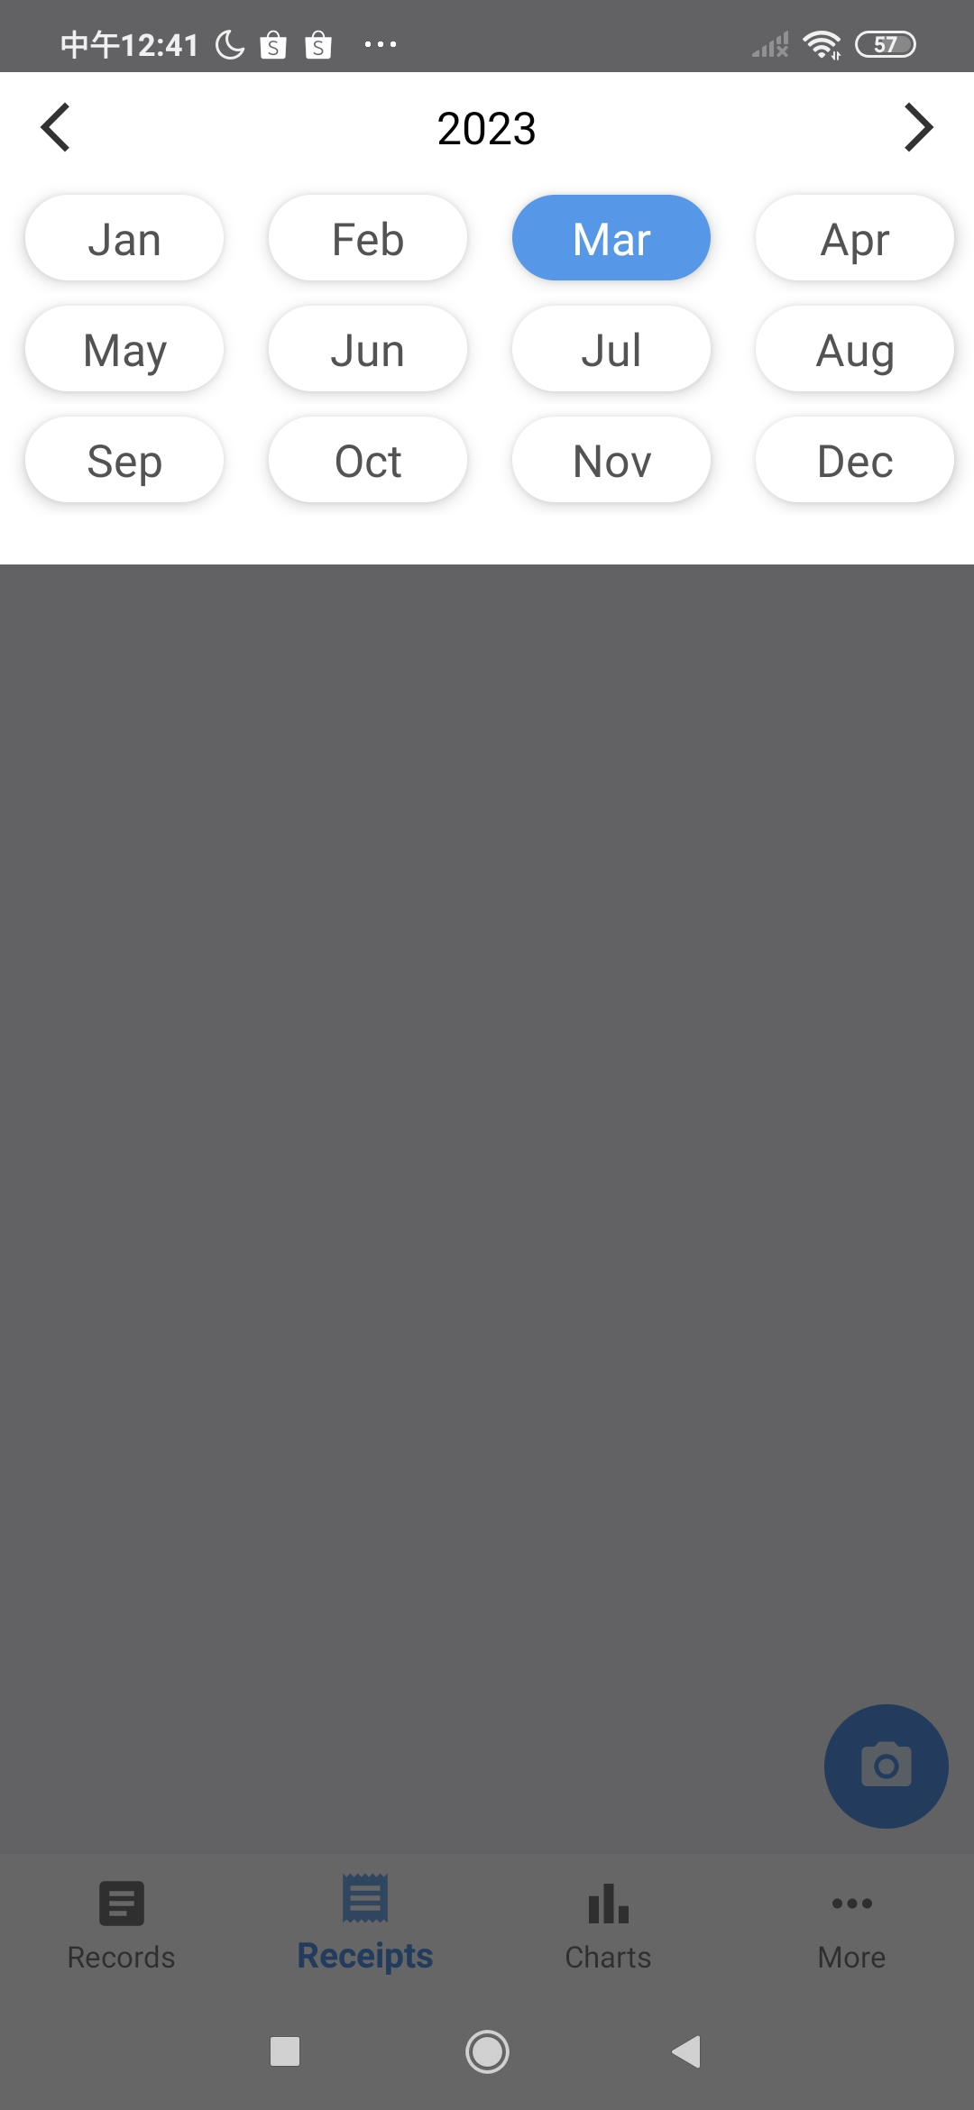
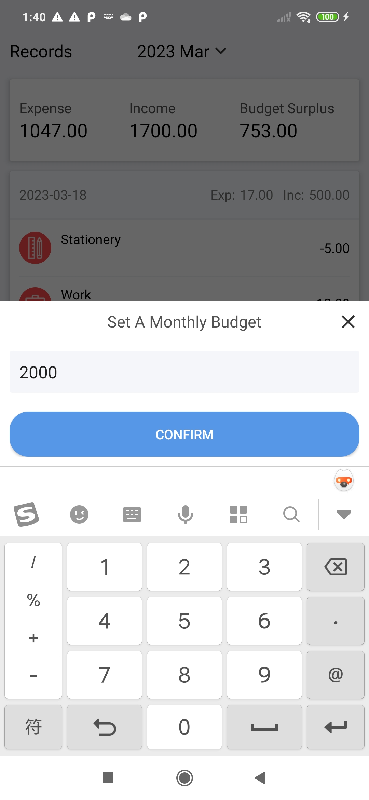
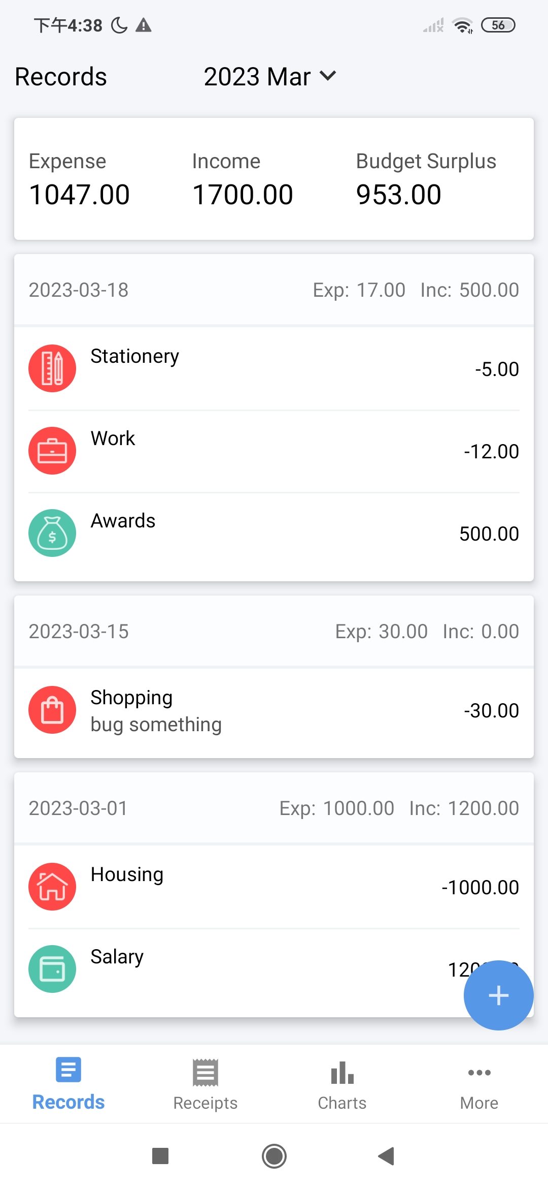

Records Management
Record List shows records for selected month
Records grouped by day with daily amount summary
Header shows monthly amount summary
Month Picker Dialog for specifying month

Slide 11
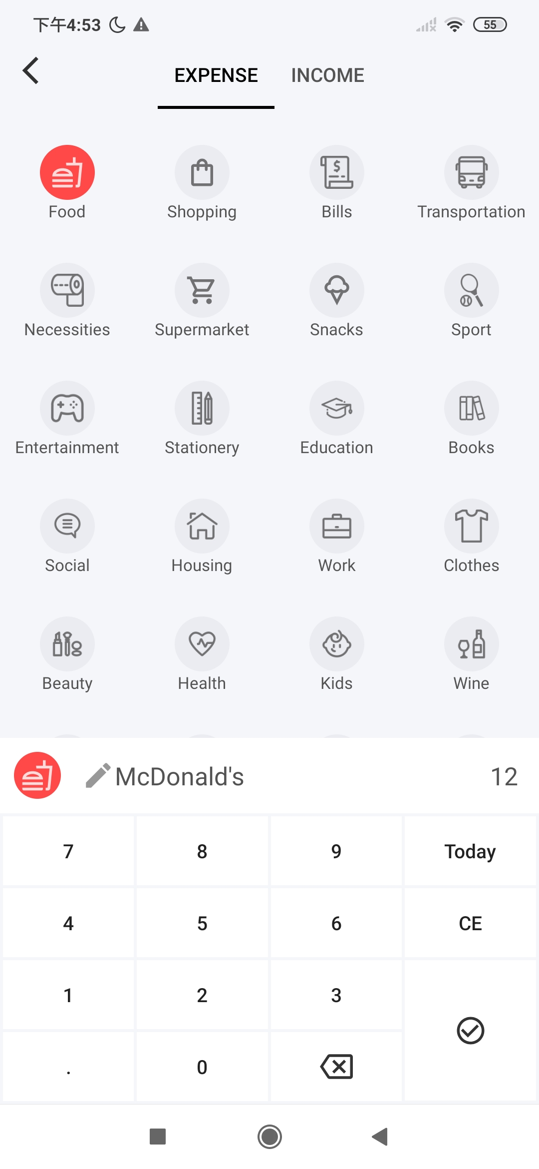
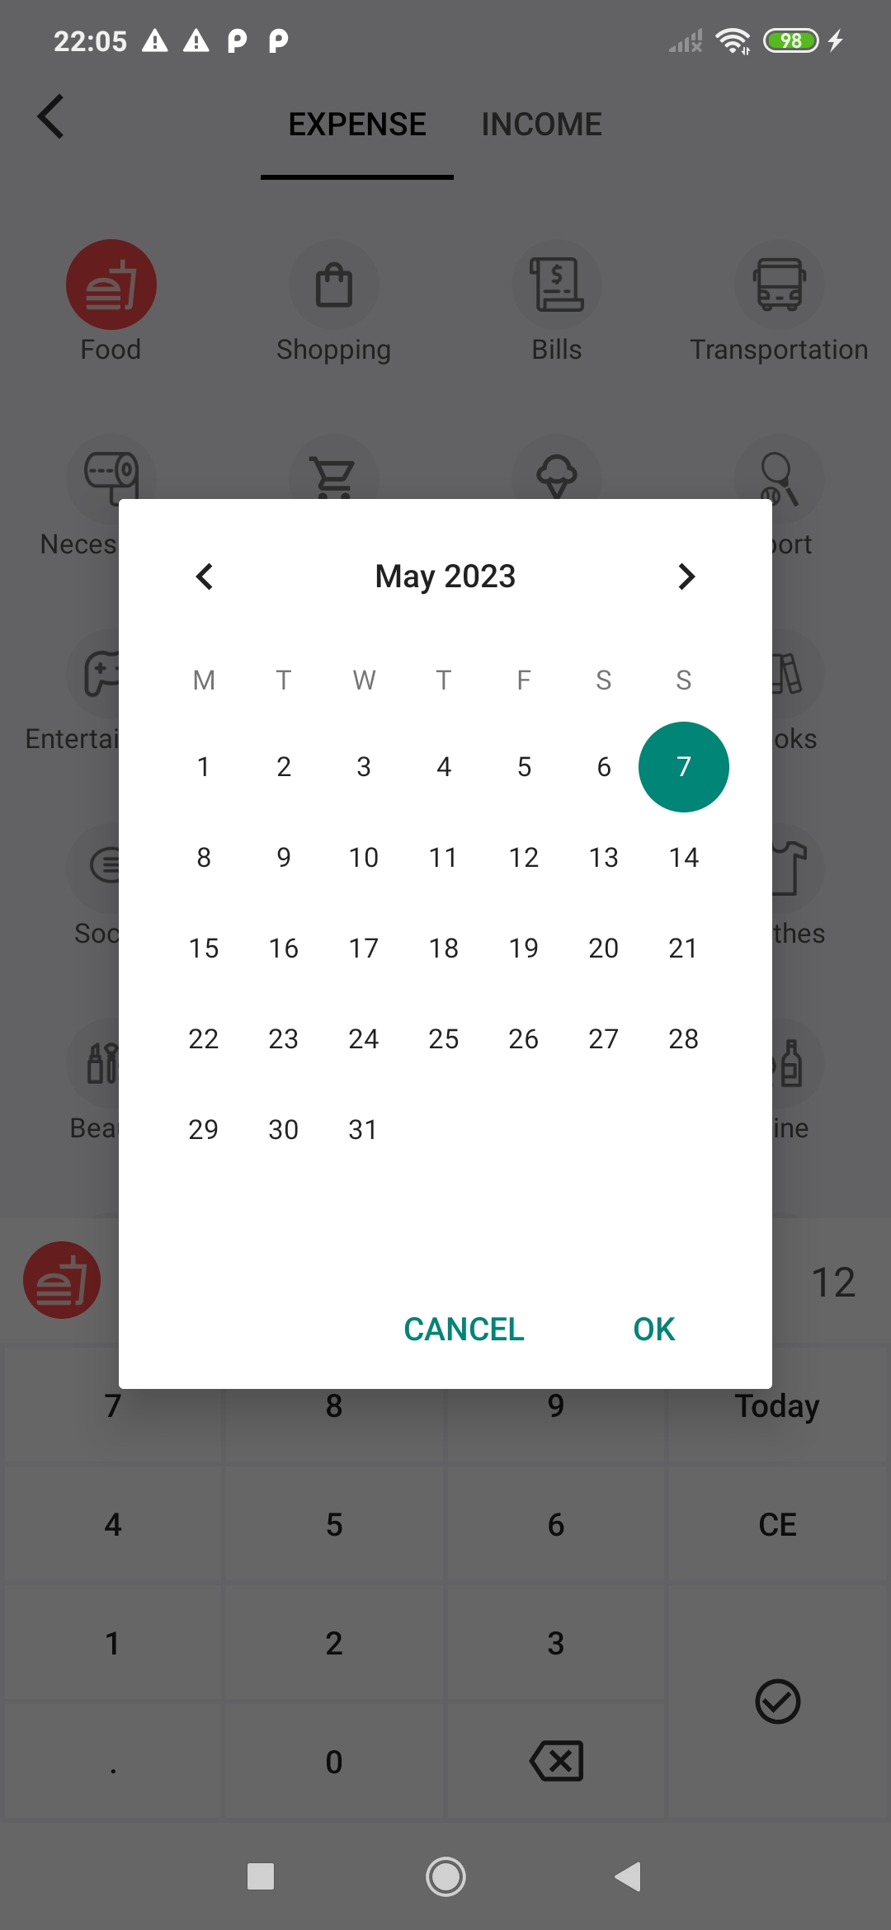
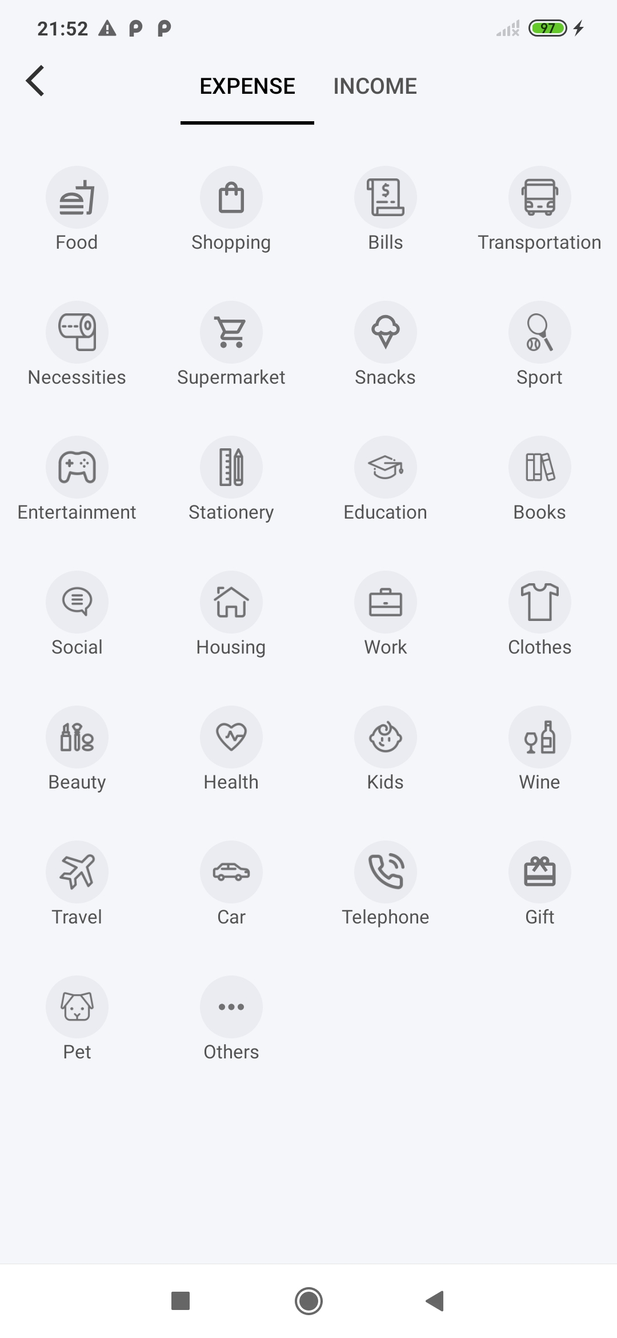
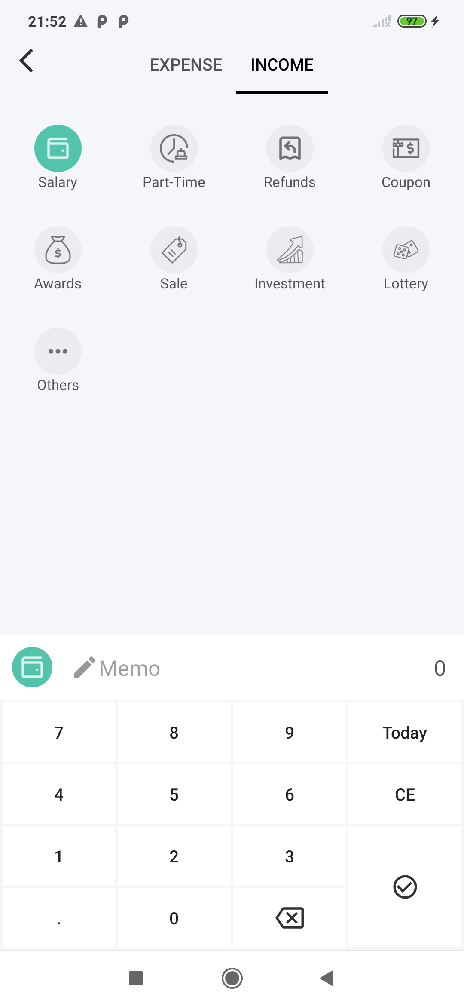
Records Management
Add New Record
Tab Layout + View Pager
Swipe to switch between Expense and Income
Fully Customized keyboard for entering details simply and intuitively
Swipe

Slide 12
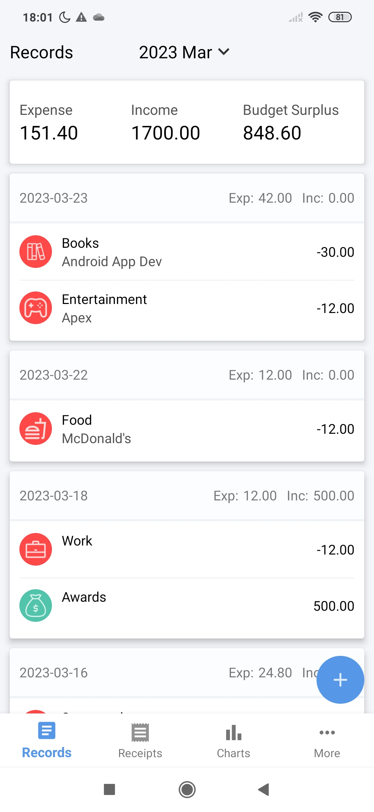
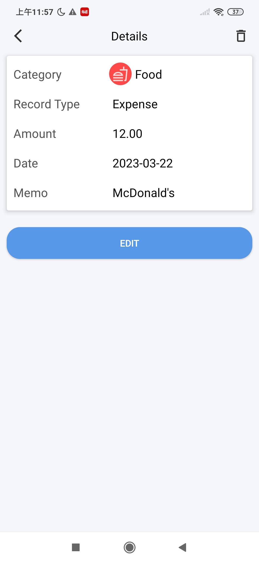
Records Management
View and edit record details
Page Re-used
Consistent user logic

Slide 13
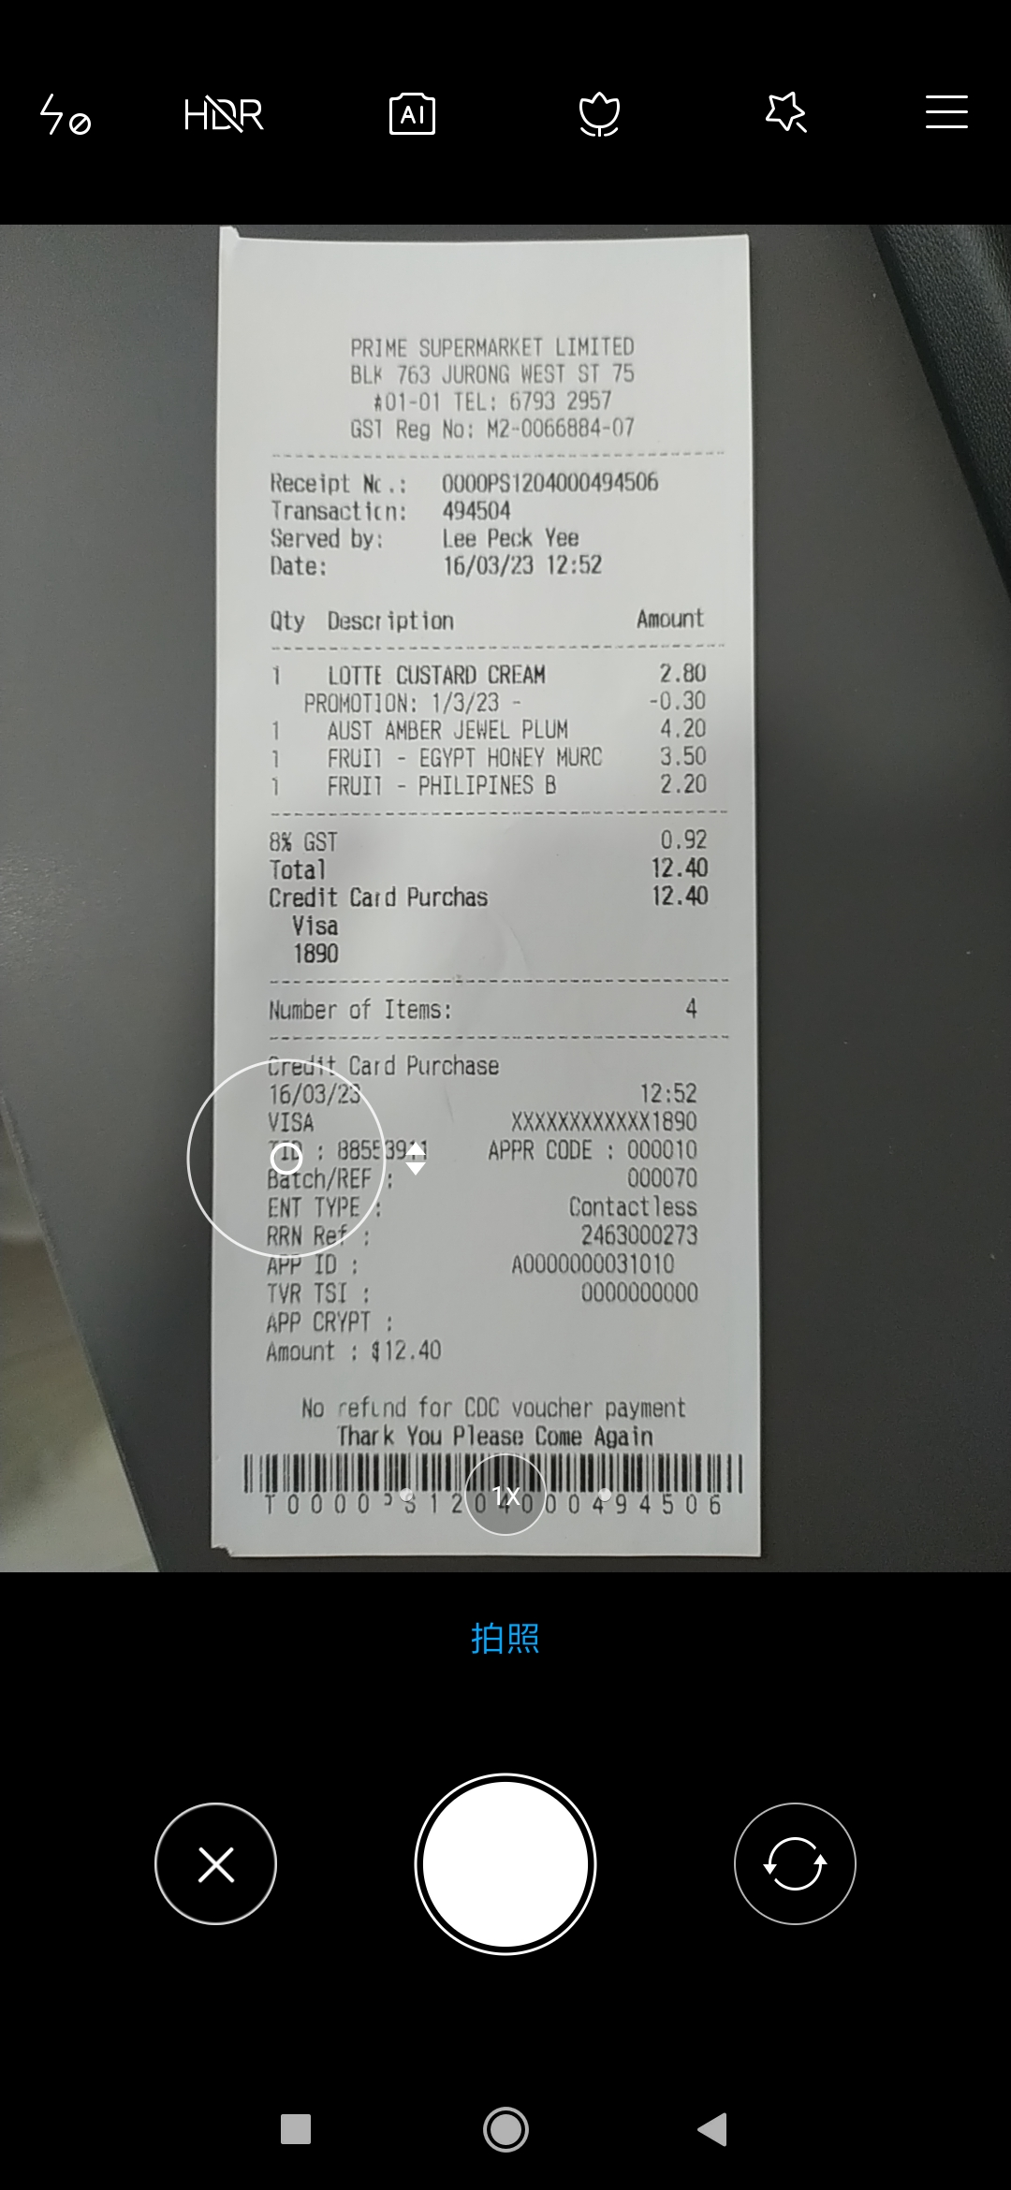
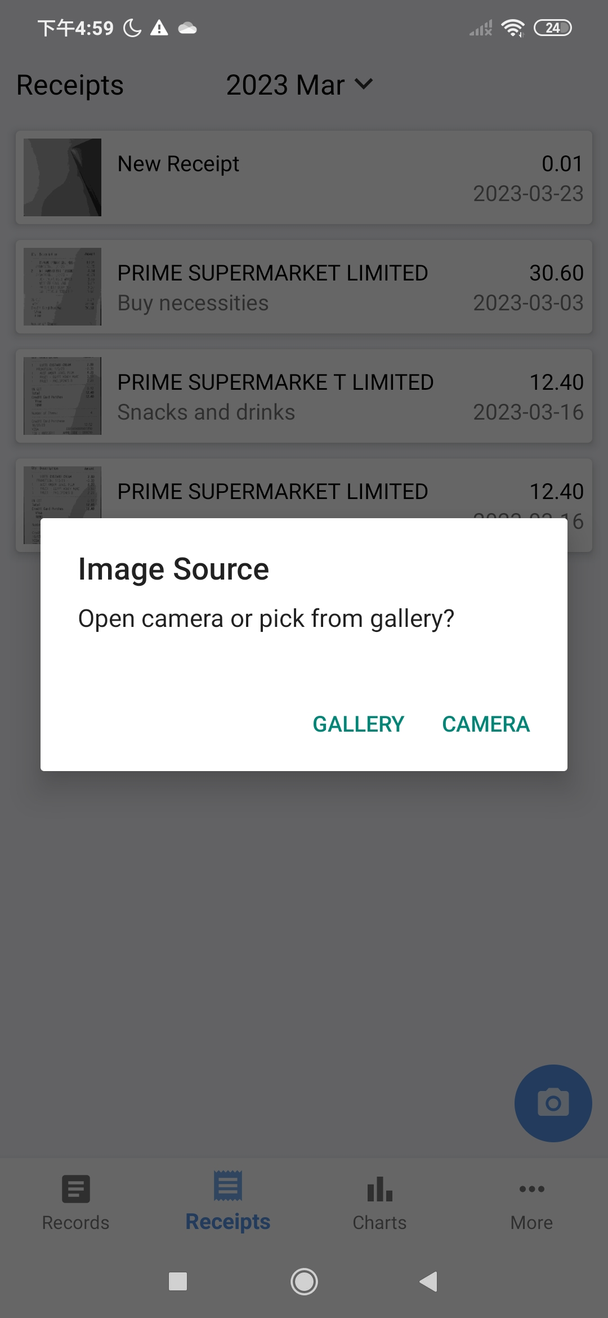
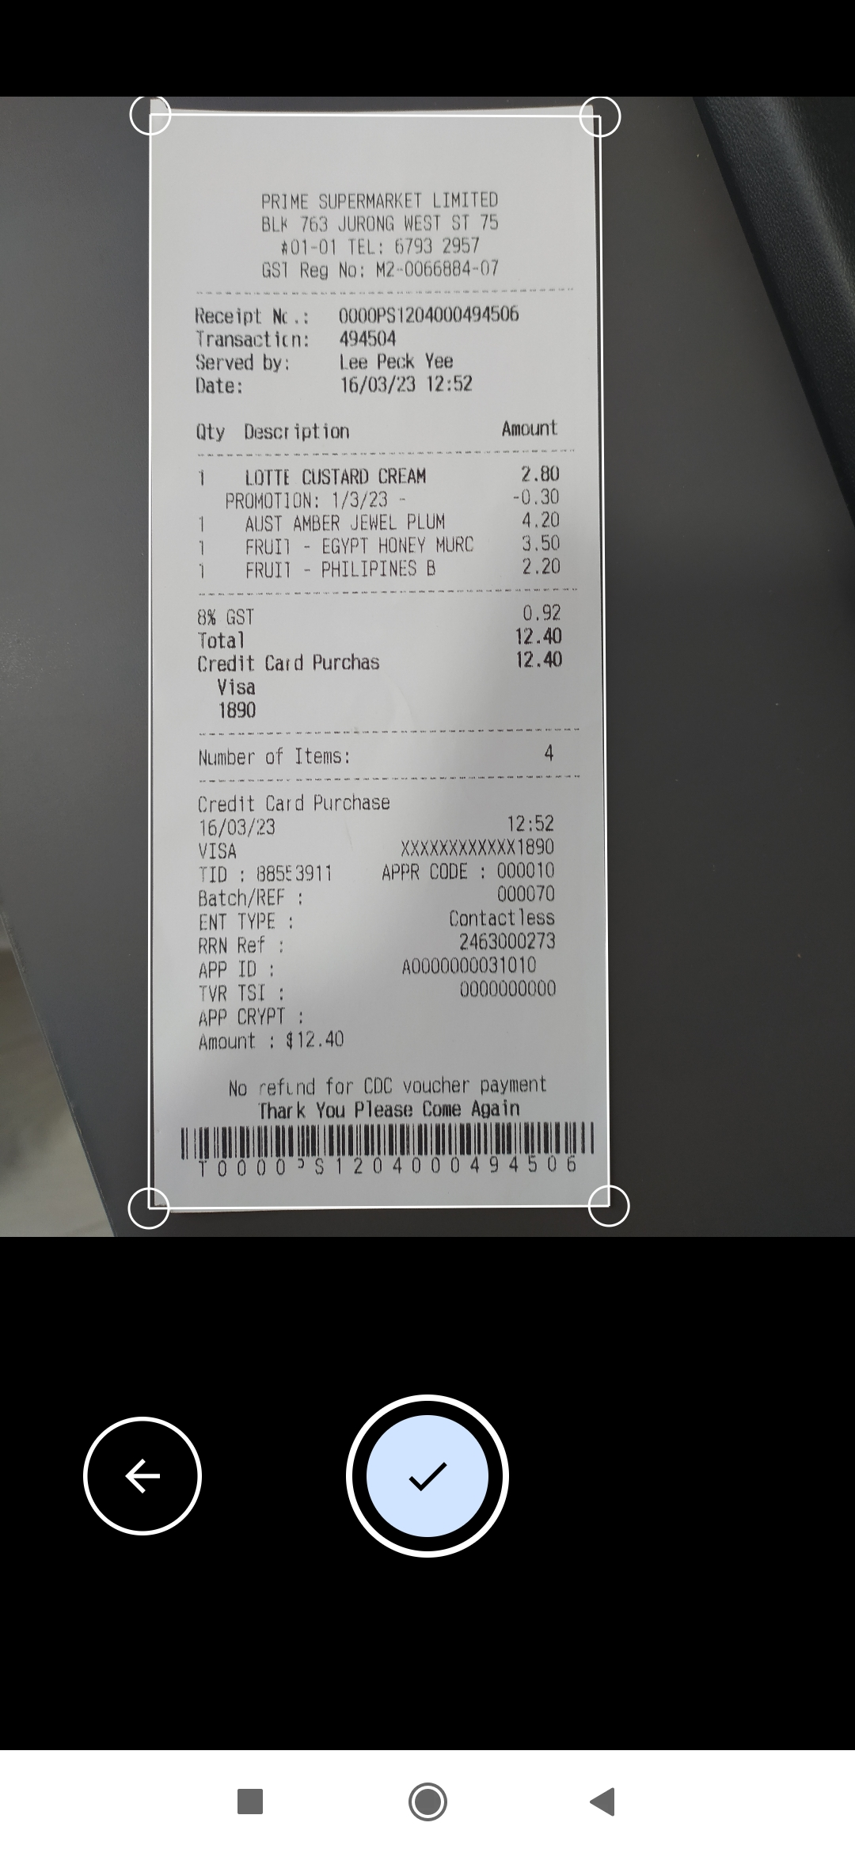
Receipts Management
Receipt List shows receipts for selected month
Input image from gallery or camera
Take photo, adjust corners and confirm

Slide 14
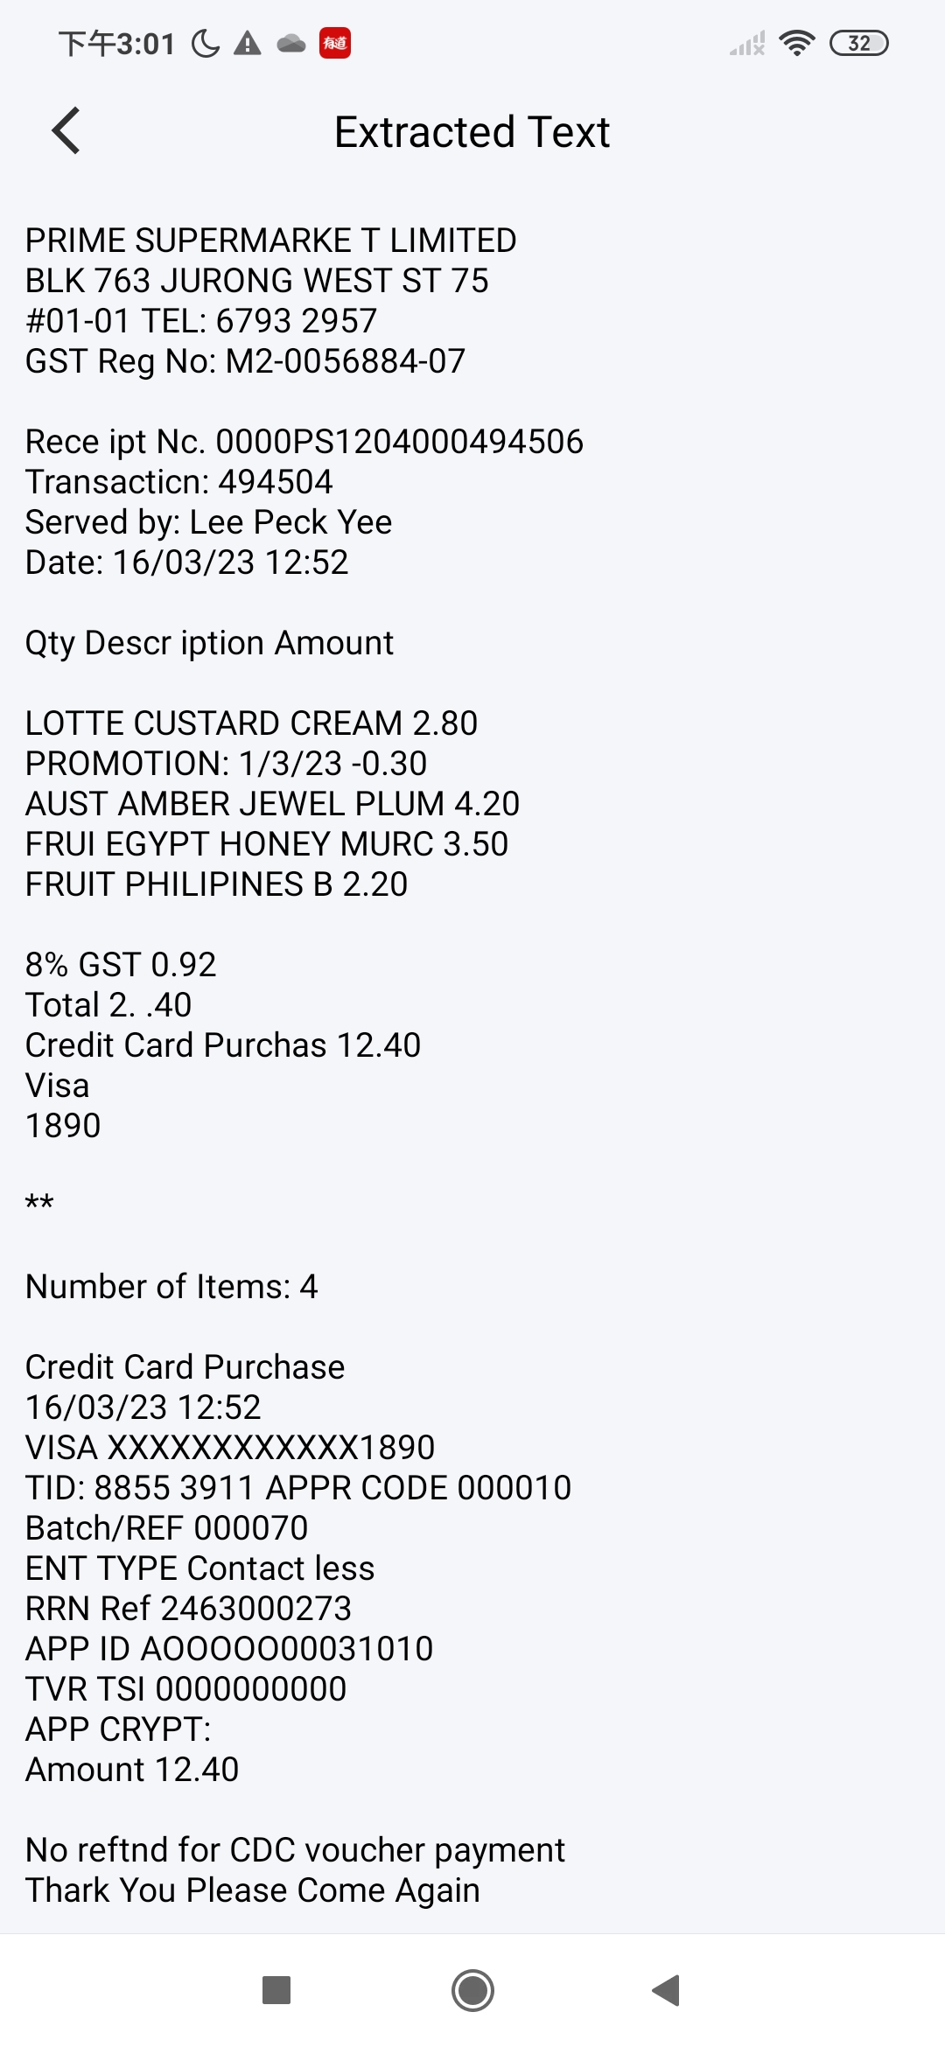
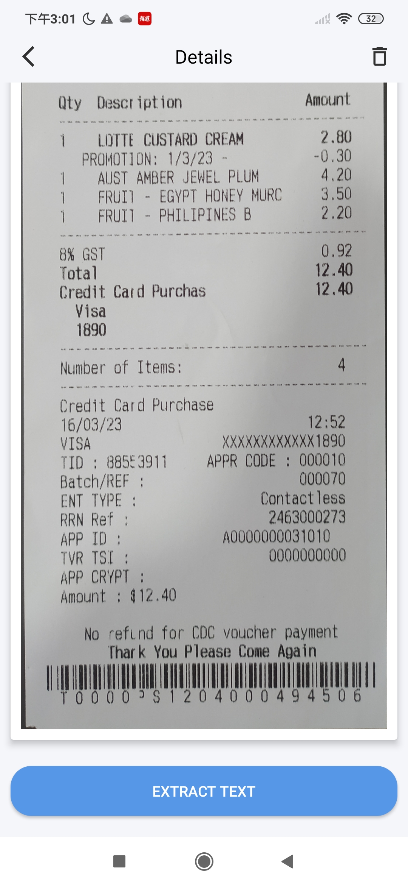
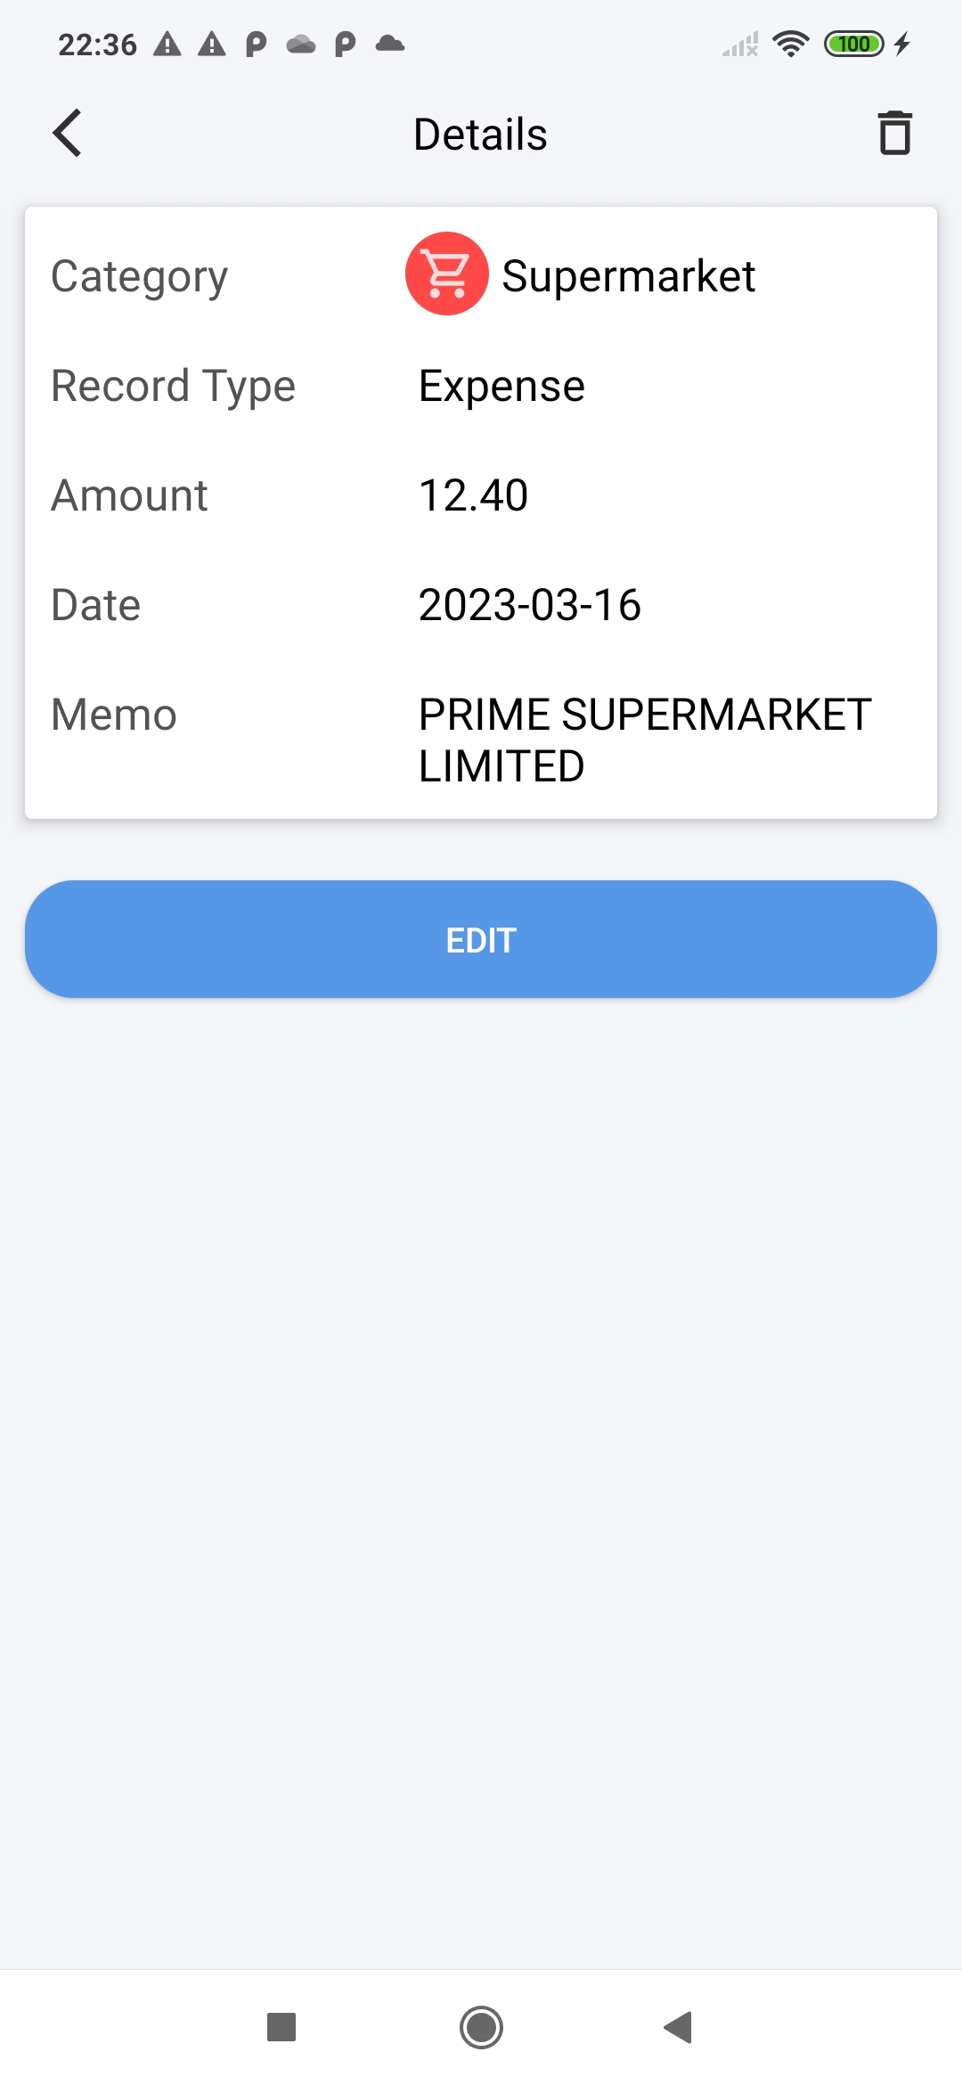
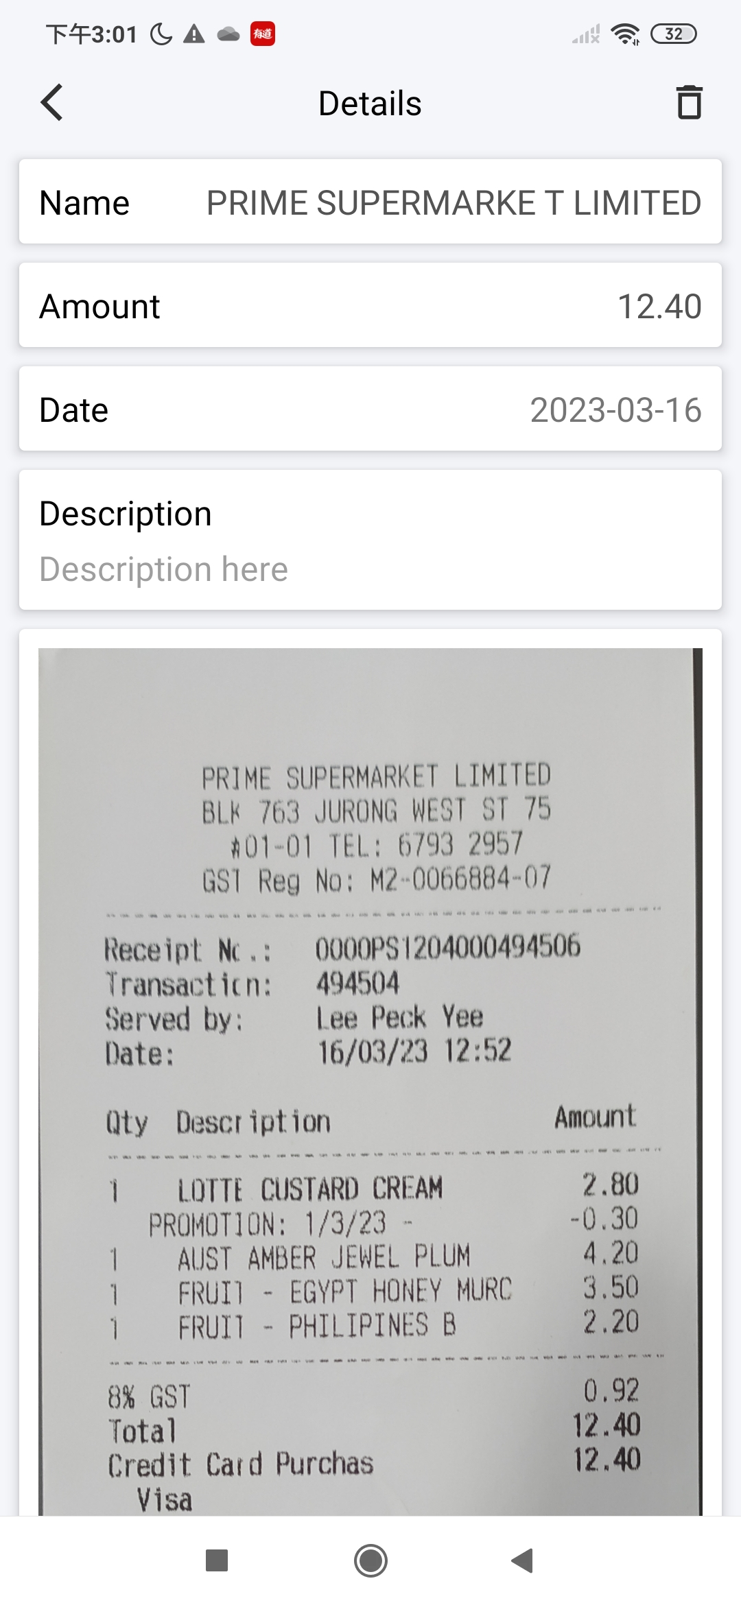
Receipts Management
View and edit receipt details
Extract texts from entire receipt image
Corresponding record created when scanning a new receipt

Slide 15
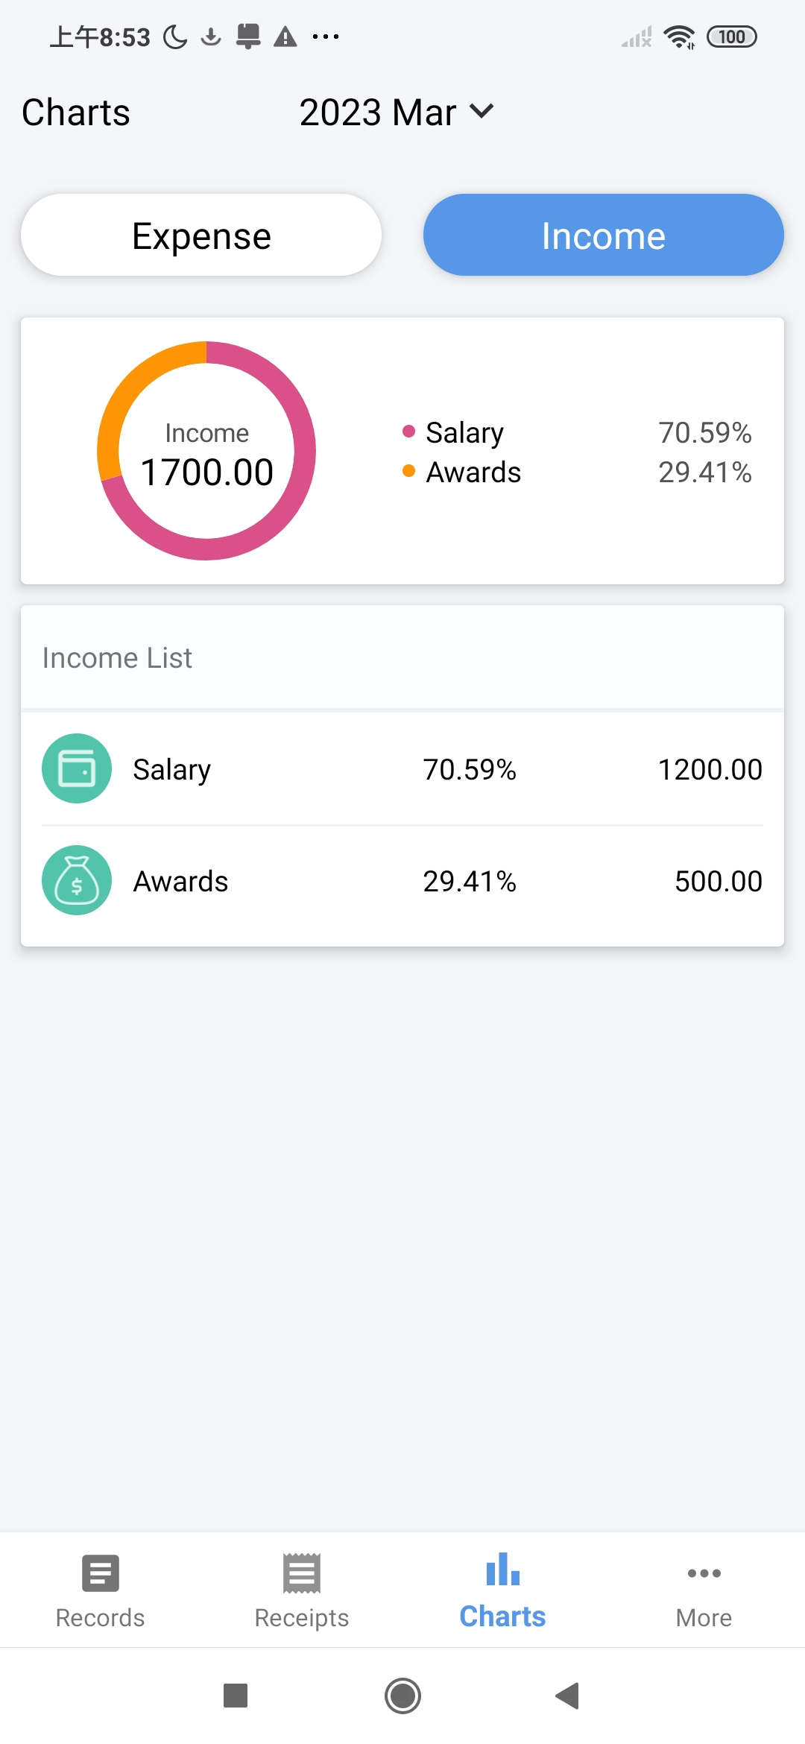
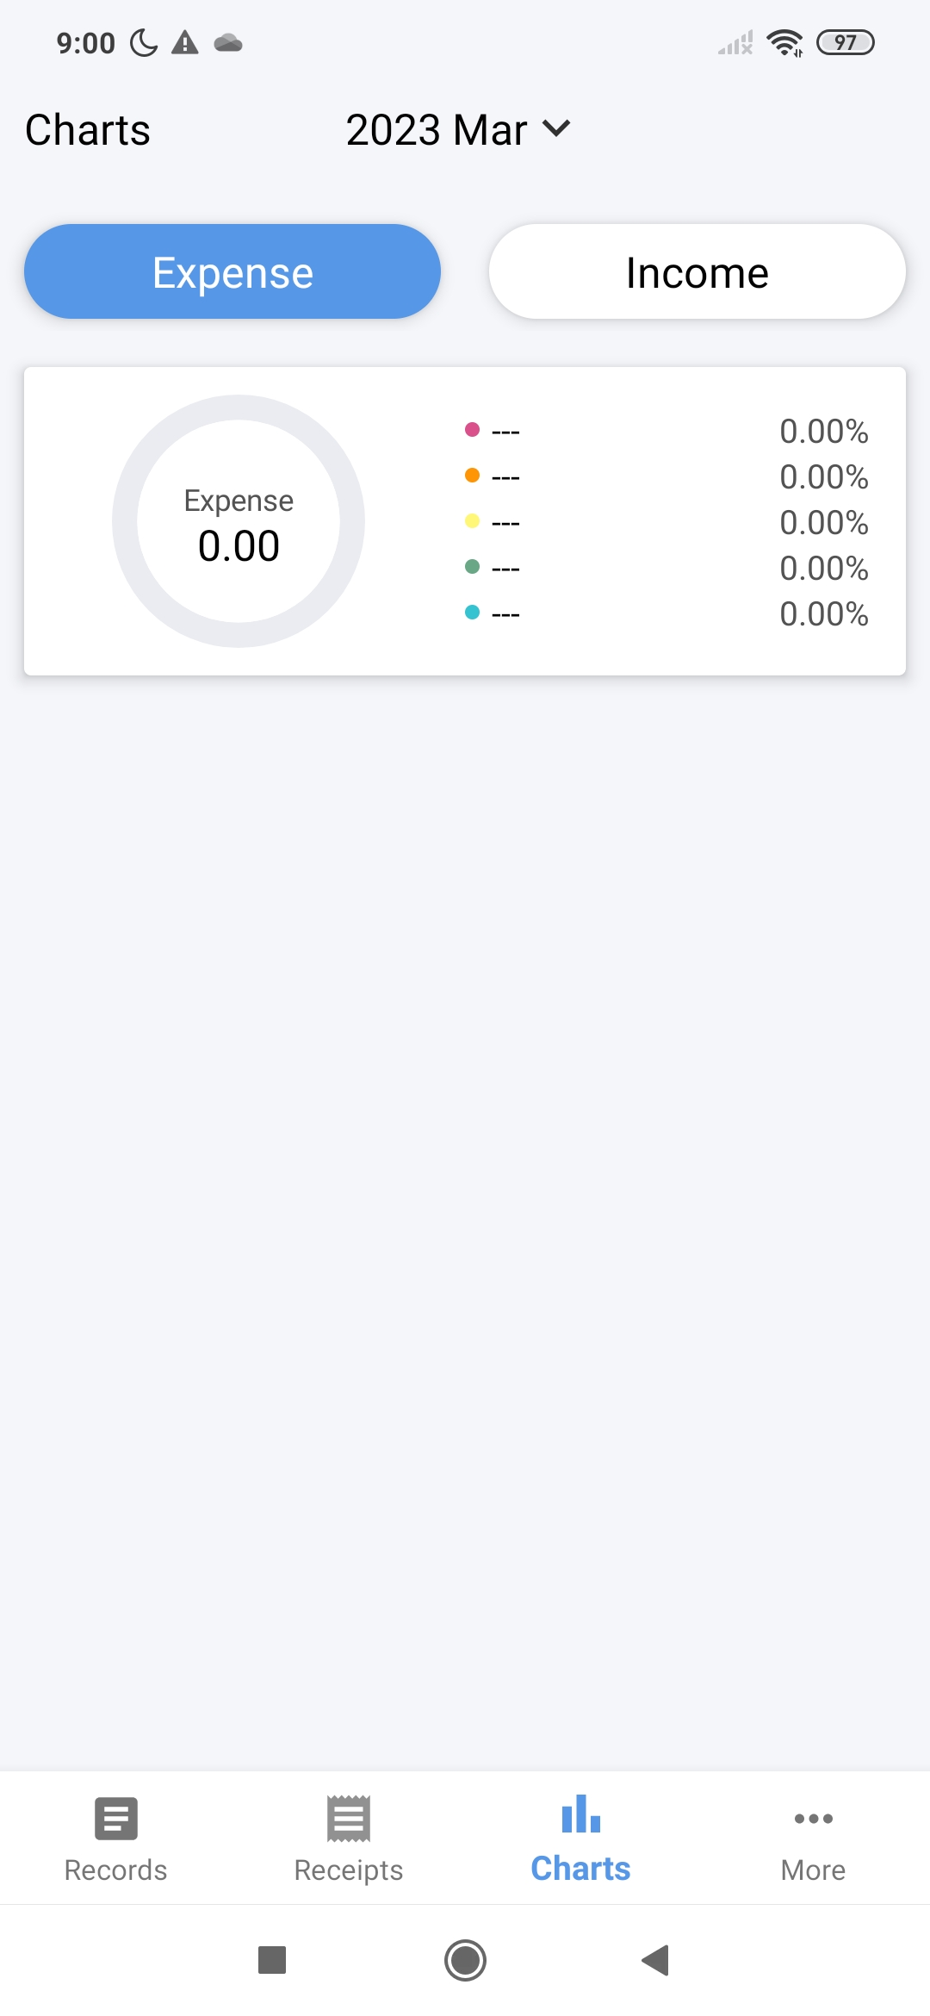
Charts & Reports
Pie Chart shows amount percentage of Expense or Income categories
Expense or Income List shows each categories total amount and percentage in descending order
Switch between Expense and Income

Slide 16
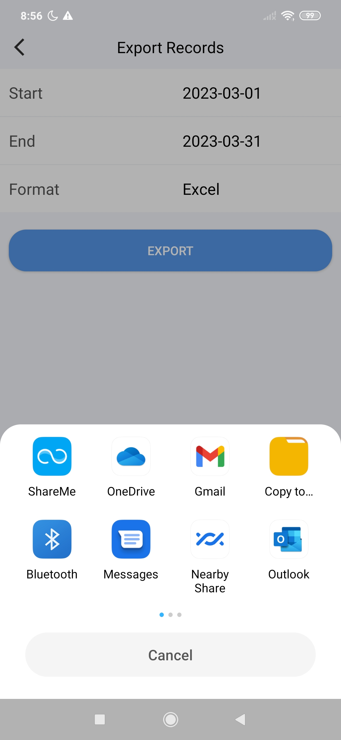
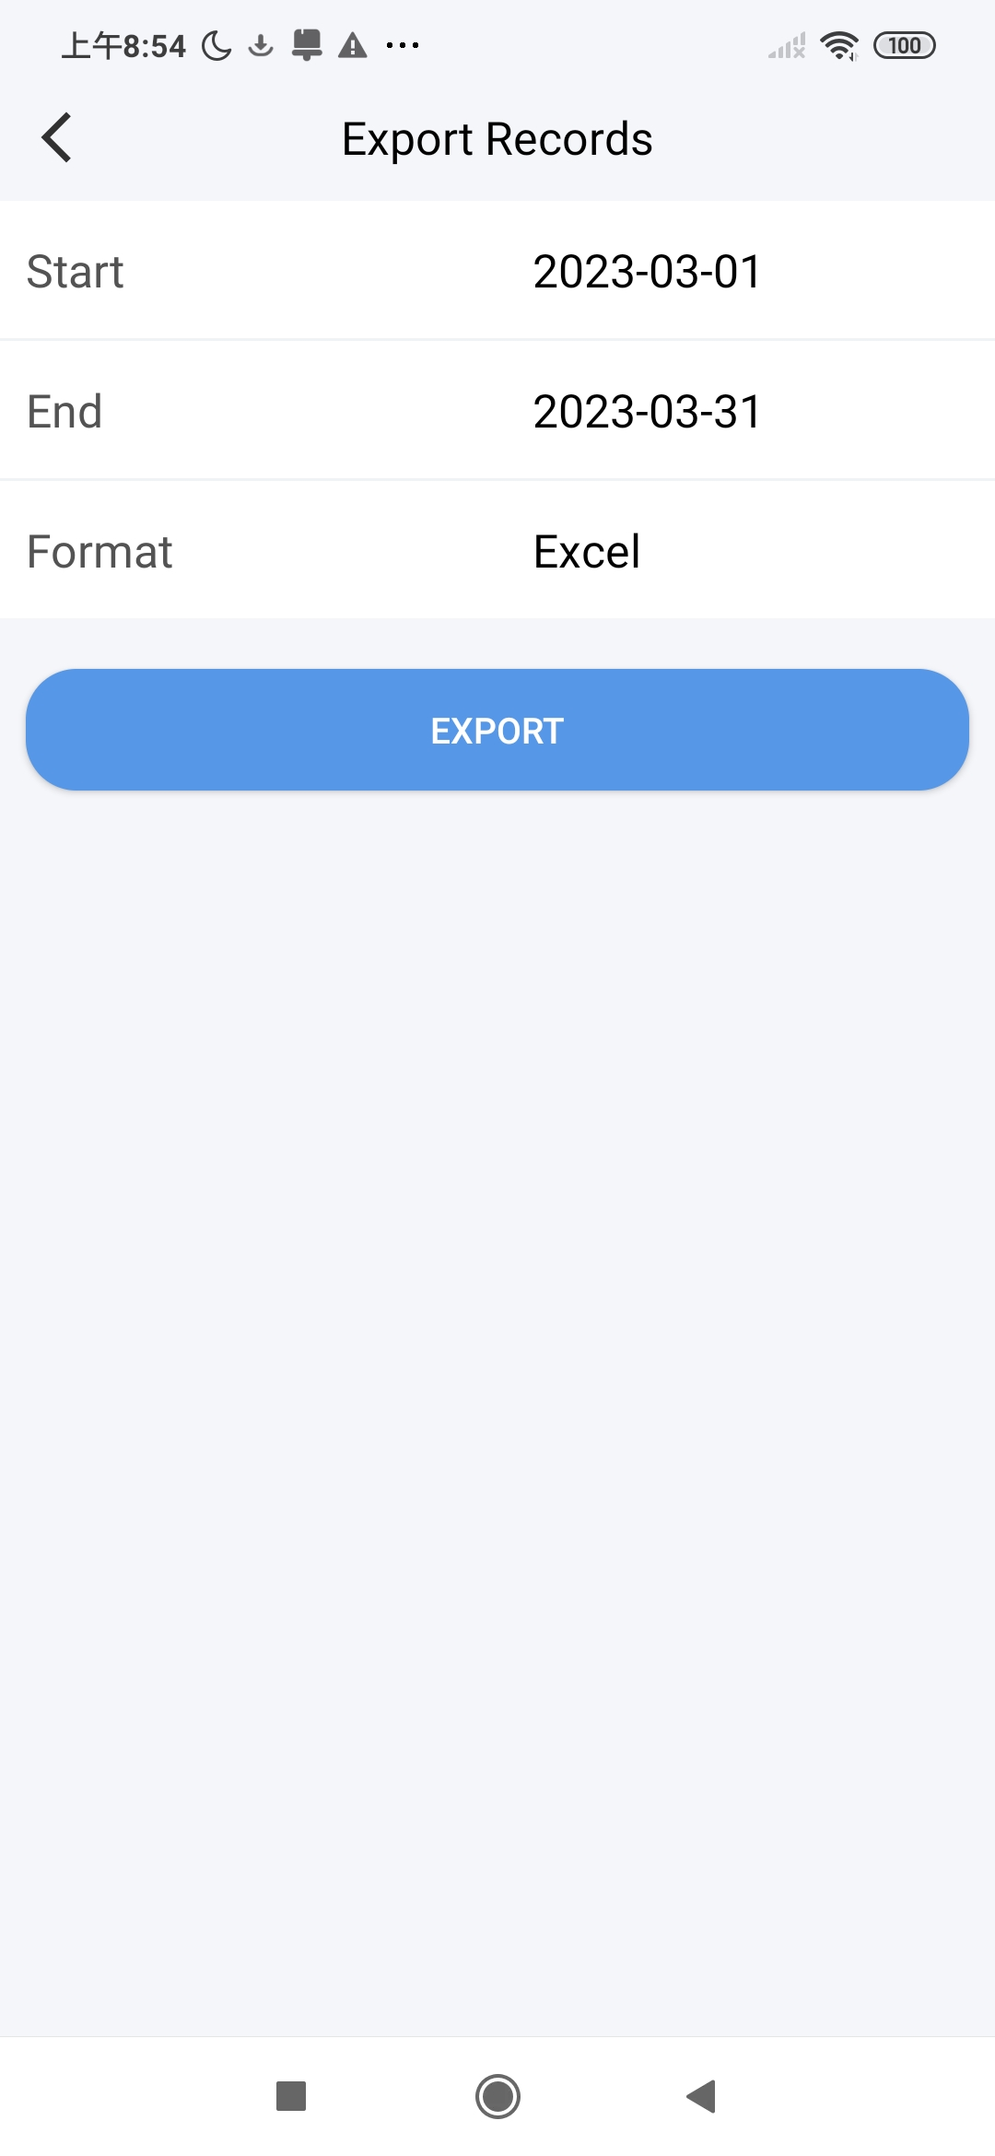
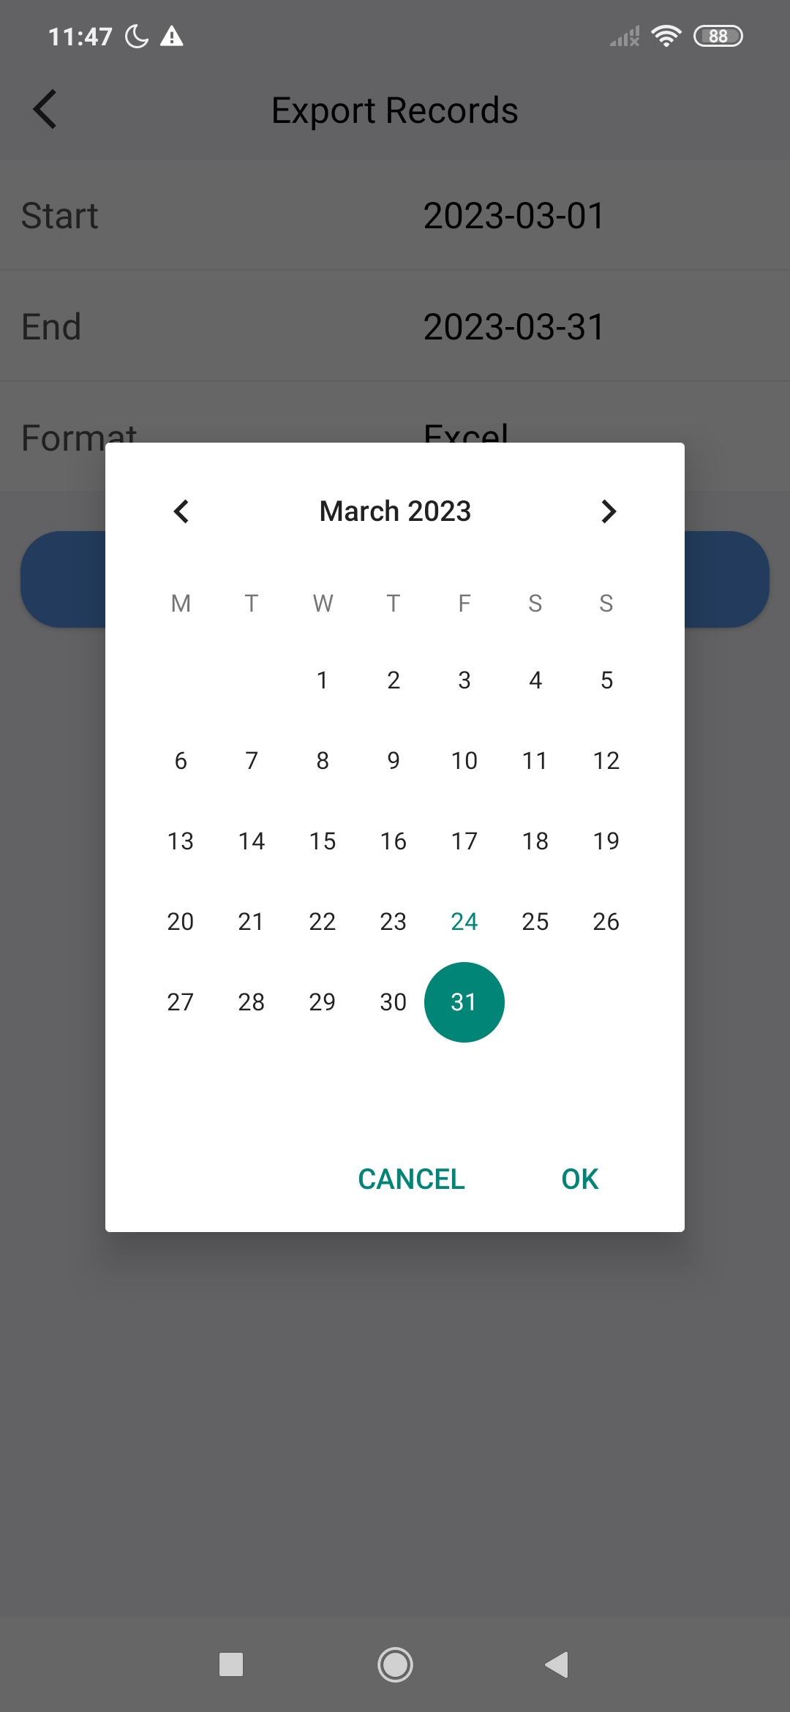
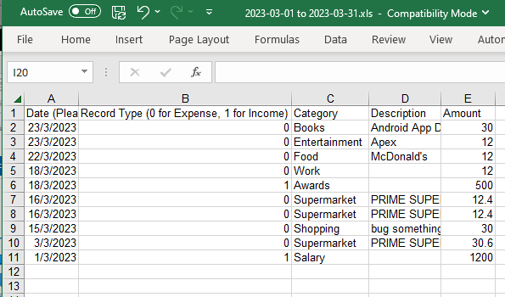
Import & Export
Export expense and income records within specified date range to Excel file

Slide 17
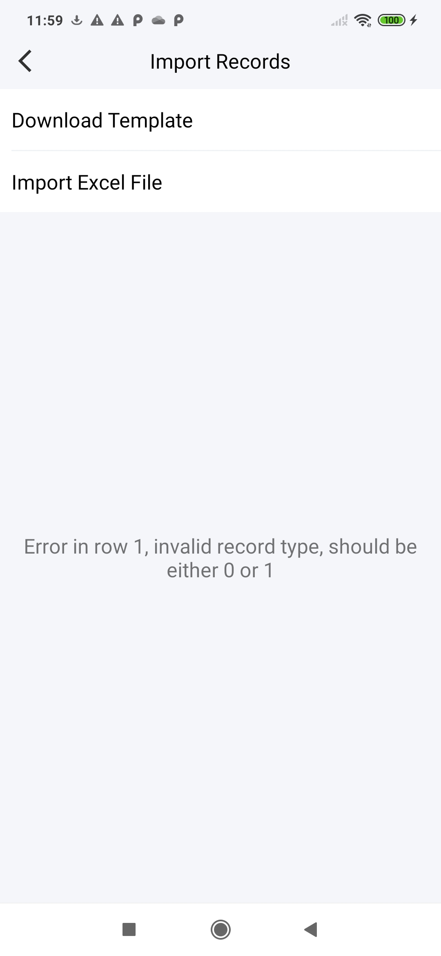
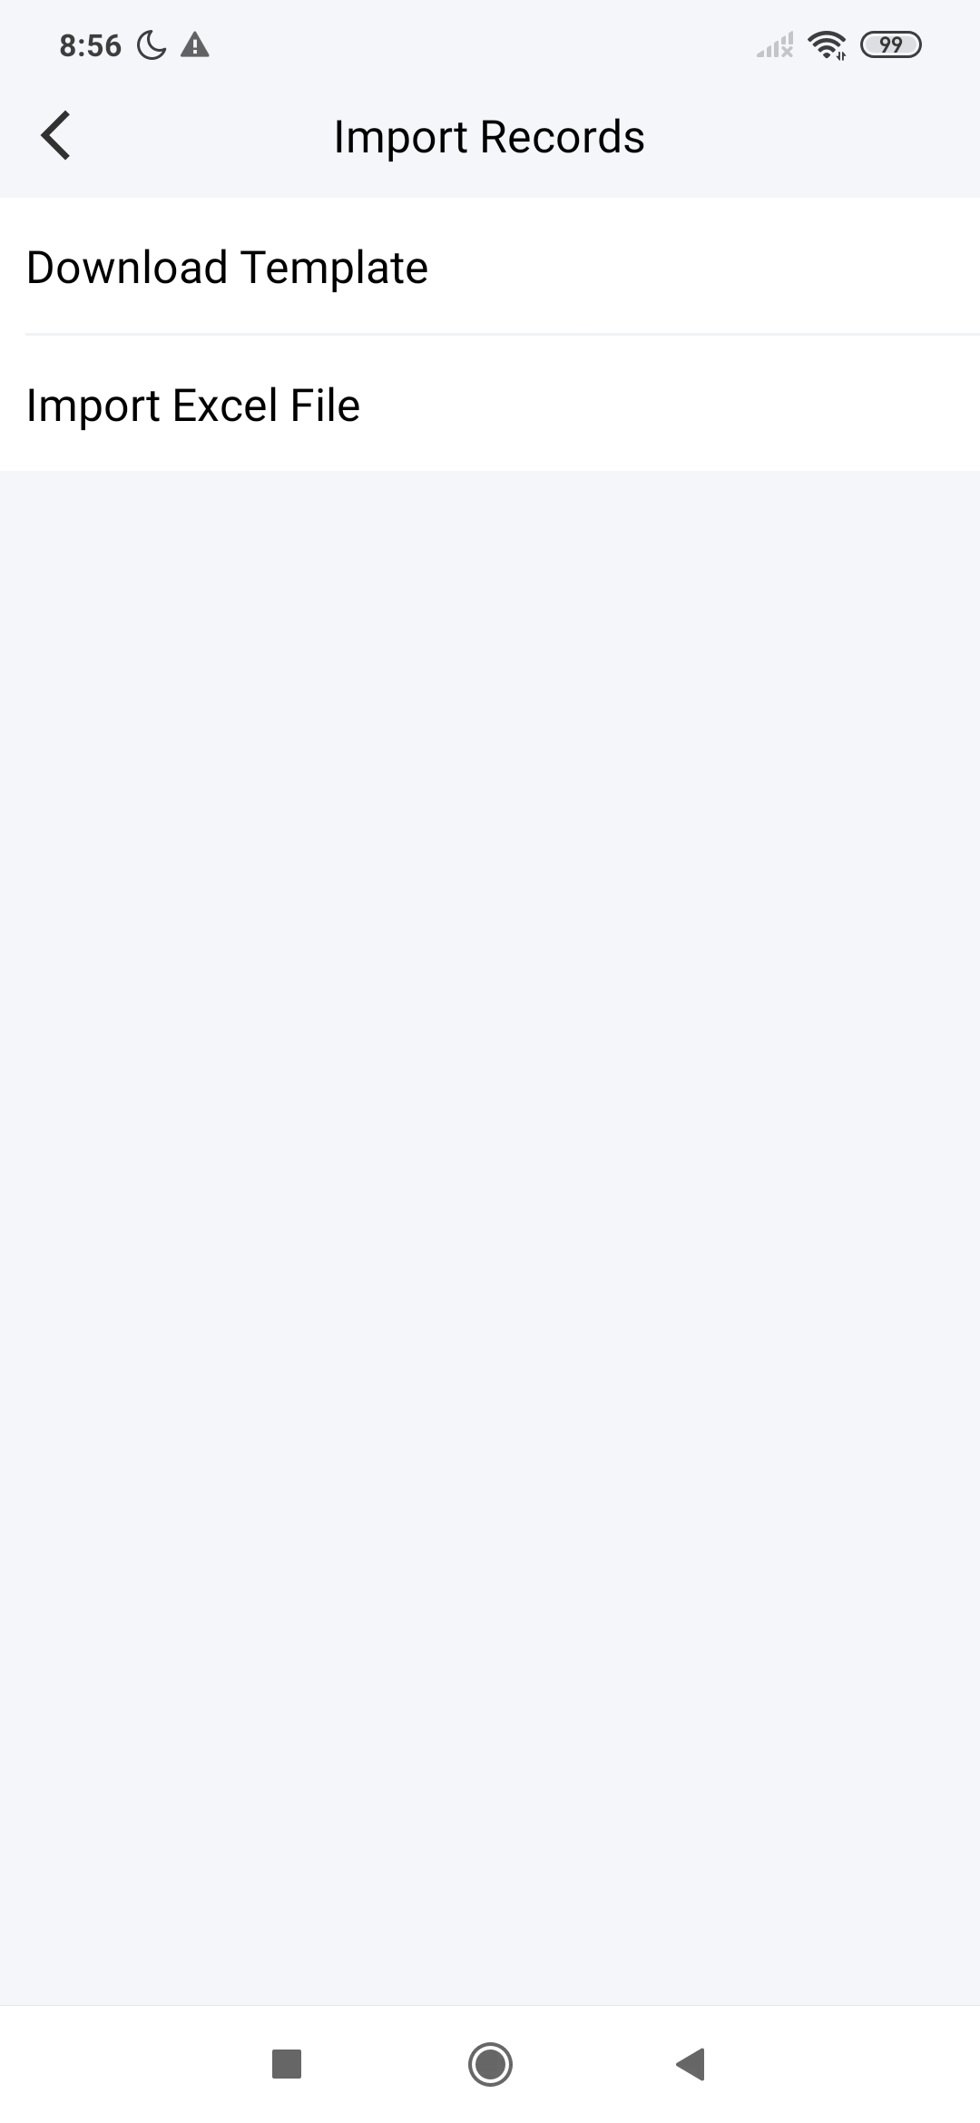
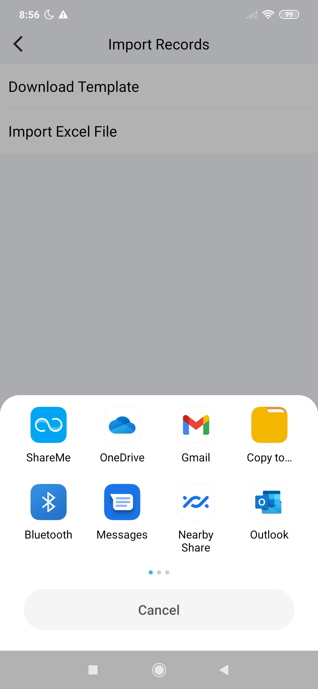
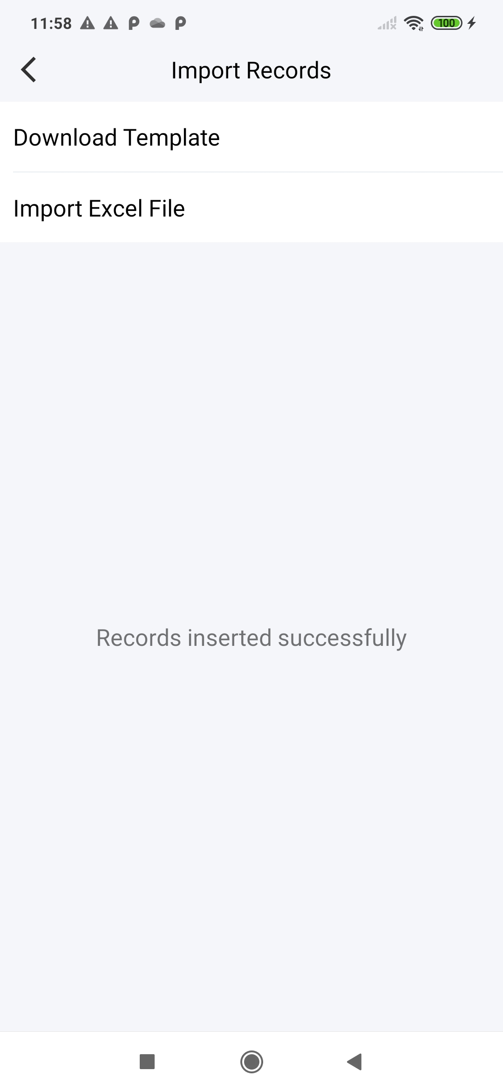
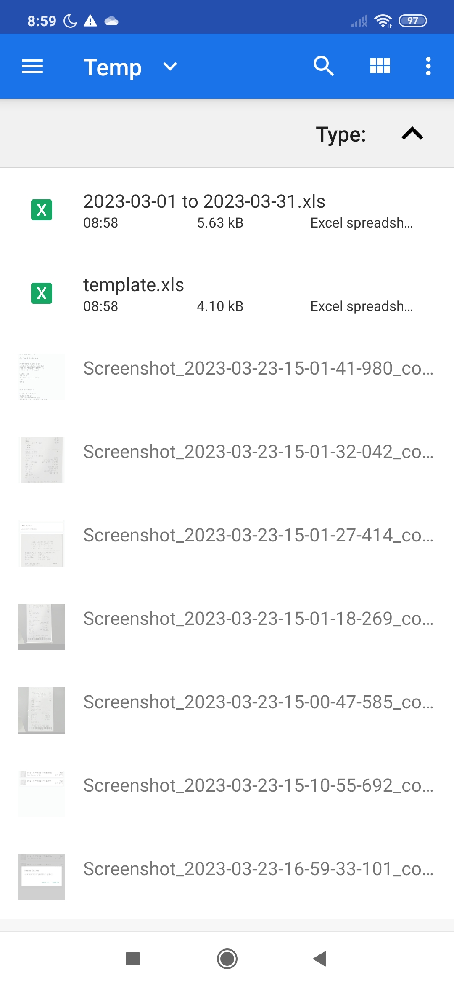
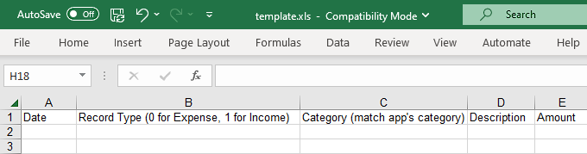
Import & Export
Import expense and income records from external Excel files
A template file with instruction can be downloaded
Appropriate messages for successful import or errors in the Excel file

Slide 18
Conclusion
Developed App
Solved Drawbacks
Learnt Skills
Powerful, easy-to-use and intelligent money tracking app
Rich features
Good performance
Inputting inefficiency
Lack of record details where receipts can help
Android App development with Java
OCR understanding and deployment
Open-source projects exploration
Problem analysis and solution development

Slide 19
Future Work
Multithreading and Asynchronous programming
Other minor but useful functions
Separate heavy operations from main UI thread.
Better performance and user experience.
Such as language setting, reminder, periodic expense or income
Better Receipt Text Extraction Algorithm
To improve accuracy of text extraction from receipt images using other information provided by the API
Cloud Service and Backup
Improved security and data integrity
Data synchronization between multiple devices

Slide 20
Thank you

